Slide 1
Y541
Pure Core
Annotated sample assessment materials
Notes:
These annotated SAMs commentaries have been developed by OCR to offer guidance on the wording of questions on the new sample assessment materials and what candidates should do in response to them.

Slide 2
Guidance
This guide is designed to take you though the A Level Pure Core Y541 sample assessment paper. Its aim is to explain how candidates should approach each paper and how marks are awarded to the different questions.
The orange text boxes offer further explanation on the questions on the exam
paper. They offer guidance on the wording of questions and what candidates
should do in response to them.
The green text boxes focus on the awarding of marks for each question.
This is a ‘show that’ question i.e. the answer has been given. A clear mathematical argument must be seen.
[this is an example]
The examiner is looking for a clear method for rationalising the denominator. [this is an example]

Slide 3
The standard summation formulae for Σr² is given in the Formulae Booklet. However, learners needs to learn the formula for Σr.
‘Fully factorised form’ here implies the factoring out the fraction (1/6) as well as the other algebraic factors.
This is a routine starter question with all AO1 marks, designed to settle learners into the exam.

Slide 4
The instruction ‘In this question you must show detailed reasoning’ is designed here to prevent learners from writing down the result using the definite integral button on their calculators (although use of calculator to check is good practice). It requires them to show the integral result as the tan⁻¹ function and then substitute limits. No marks would be awarded without this working. The notation ‘arctan’ for ‘tan⁻¹’ is acceptable. The standard integral required is provided in the Formulae Booklet.
Substituting x = 4 tan u would of course be an equally valid method.
All the marks here are routine AO1 marks. The ‘DR’ in the mark stands for ‘detailed reasoning’. The final answer here must be given in exact form for the final A1 to be earned.

Slide 5
Part (i)
The difference method for summation of series requires accurate use of notation. Sometimes learners confuse ‘r’ (the rth term) with ‘n’ (the nth term), so it is important in teaching this topic to make a point of clarifying the different roles of r and n.
The AO2 mark awarded here is for interpreting the sigma notation.
The cancellation process needs to be clear by showing enough terms (indeed perhaps more than are shown in the answer column here – the third to last term would enable the cancelling of the 1/n terms to be shown).
Many candidates might wish to combine the fractions in their final answer – if errors are made in doing this, these are sometimes condoned using ‘isw’ (ignore subsequent working).

Slide 6
Part (ii)
Simply stating the result of 3/2 here (viz an ‘unsupported answer’) would not gain the mark – the limit process needs to be shown.
The AO2 mark awarded here is for the explanation.
The arrow notation could possibly be replaced by a satisfactory explanation in words.

Slide 7
This question uses the command word ‘Determine’ so a clear mathematical argument, and not just the answer is needed. (Notice also the number of marks.)
Notice the use of the identity (‘≡’) symbol in the question, which is included in the ‘miscellaneous symbols’ section included in the specification. Students should be aware of the difference between an equation and an identity, though use of the ‘≡’ symbol in their working is not mandatory.
The introduction of the variable ’k’ here lifts this question above a routine partial fraction question and demands a degree of ‘problem solving’ ability – hence the AO3 marks awarded.
Most solutions will include C = 1, but, as this is not required to answer the question as set, it gains no mark.
Many candidates might offer k = 1 as a solution, without noticing that B has to be positive. Notice that the E1 is for the full correct set.

Slide 8
The ‘detailed reasoning’ statement is designed to penalise use of a definite integral button on calculators (although learners might have difficulty finding an ‘∞’ button, using a sufficiently large value will give an approximation for checking the final answer).
In the mark scheme, the ‘limits’ method mark requires candidates to make a decent attempt at the integration by parts – notice that omitting the −2xe^{−x} term would still give the correct answer, albeit fortuitously, so would lose all the marks (as ‘A’ marks can only be awarded if the preceding ‘M’ mark is gained).
Note here that they are required to show some evidence of evaluating the limits.
It is always worth encouraging your students to show more working than they might feel is necessary, especially in a ‘detailed reasoning’ question like this.

Slide 9
Finding the angle between line and plane is a straightforward specification item.
This is a somewhat more exploratory task, requiring the learner to find the angle between the line and the normal to the plane, and deducing that this is a right angle. This means the line lies in the plane, which requires testing a point on the line to see if it lies in the plane, or is parallel to the plane. ‘Determine’ indicates that the thought process needs to be seen, and not just a conclusion.
The only minor difficulty to negotiate here is the obtuse angle given between the line direction vector and the normal to the plane, which merits an AO2 mark.
The element of investigation here justifies a mark scheme covering aspects of AO3 (problem solving) and AO2 (mathematical argument).

Slide 10
This task requires learners to use the Maclaurin series for sin x to write down the first two terms of the expansions for sin x, sin 2x and sin 3x, and pick out the first two terms of the product of these.
Maclaurin series questions fall into two distinct types, either formulating a series from the general formula, by repeatedly differentiating f(x) and substituting x = 0, or, as with this question, using the standard series in the Formulae Booklet.

Slide 11
The two method marks here could be awarded by following though incorrect answers to part (i).
Calculators are not likely to achieve the exact surd answer. It is quite common that candidates who are perhaps too fond of using their calculators ignore instructions for an ‘exact’ answer, so they need to be aware of what this requirement entails.

Slide 12
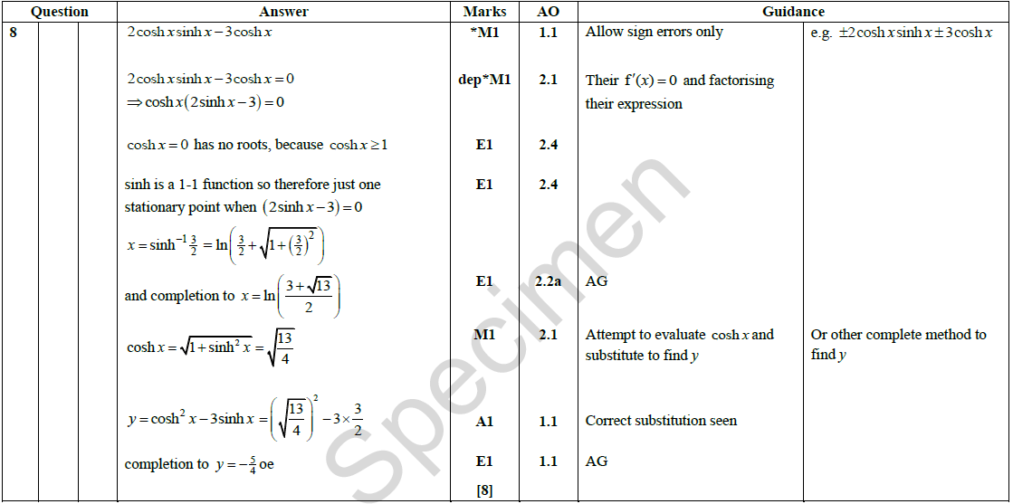
This is a ‘show that’ question i.e. the answer has been given.
Where a result is given in this type of form, it enhances the necessity for solutions to show enough working to justify the result.
Although finding the stationary value of x is routine here, care needs to be taken to establish the uniqueness of the point – see the AO2.4 marks (for explaining their reasoning) awarded for justifying this – and showing the exact logarithmic value of the x-coordinate and the exact y-coordinate.
Examiners will check that an answer has not been ‘fudged’. If a sign error is identified then care is needed to correct throughout the response steps.

Slide 13
It is straightforward to derive a polar equation by substituting x = r cos θ and y = r sin θ. However, showing that cos⁴θ + sin⁴θ = 1 – ½ sin²2θ requires some thought. An alternative method would be to use x⁴ + y⁴ = (x² + y²)² – 2x²y² = r⁴ – r⁴sin²θ cos²θ = r², etc.
It is hard to predict when setting papers what methods candidates are likely to use, so mark schemes evolve to encompass other valid methods. The principle here is that work of equal merit should gain equal marks.

Slide 14
The convention for polar curves adopted by this specification is that r ≥ 0.
Here, there is a clear AO2 mark for spotting the significance of range of values for sin 2θ.

Slide 15
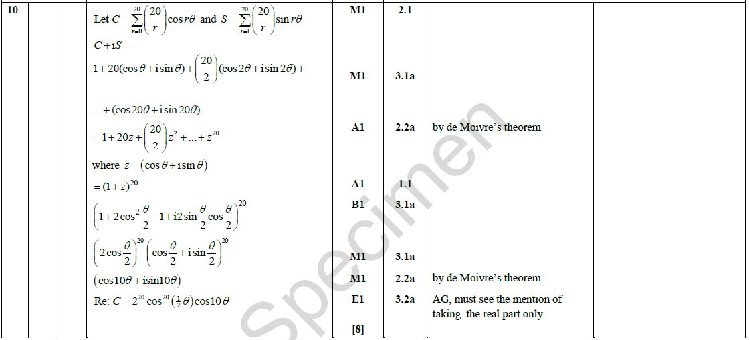
There is a requirement of all mathematics specifications to include some extended tasks requiring multiple stages in developing a solutions. You should expect some questions like this, which are relatively unstructured and require extended argument.
The C + iS method for summing trigonometric series like this one looks complicated to learners at first acquaintance, but questions like this all share a common method of solution, by combining the series for sine and cosine to get a geometric series with complex common ratio. Perhaps the trickiest part of this ‘show’ is converting 1 + cos θ + isin θ into half angles in order to split the result into real and imaginary parts. With practice, tasks like this one which on first acquaintance look complicated can eventually become routine!

Slide 16
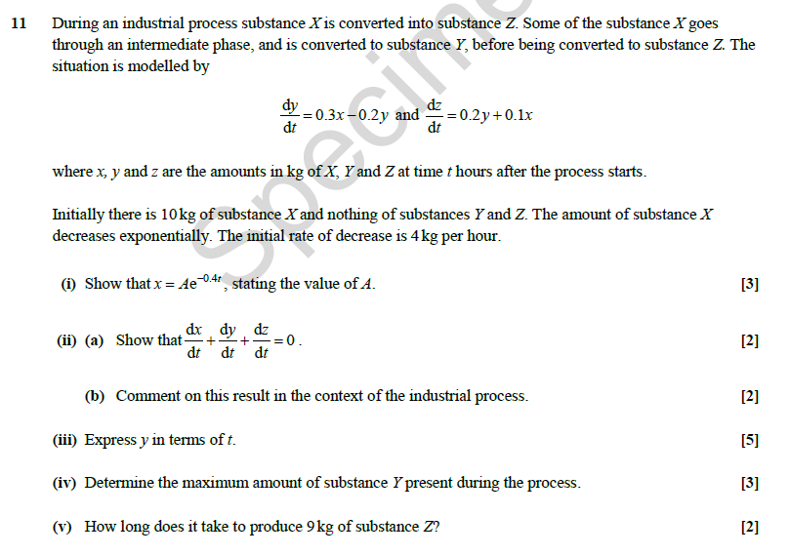
Most of the mathematical modelling requirements of the Further Mathematics specification will be covered by the applied mathematics units. However, differential equations is a topic which clearly lends itself to modelling real-world situations, so learners should expect questions like this one on linear systems set in a ‘real world’ context, albeit a simplified one.

Slide 17
In part (i), learners are required to interpret ‘decreases exponentially’ as x = Ae^{kt} or Ae^{−kt} and fit the initial conditions to find A and (their) k.
As a ‘show that’ question, a clear argument is needed to justify how the given answer is obtained.

Slide 18
The AO3.4 mark here is for ‘using mathematical models’.
This part (ii) requires a response in context.

Slide 19
Part (iii) is looking to eliminate x to find a differential equation in y and solve this.
The mark scheme implies an integrating factor method, but an alternative solution would be use the complementary function and particular integral method.
Two methods shown in the m/s for (iv), although perhaps the easiest way is to find the maximum of y = 15l − l² , where l = e^{−-.2t}, by completing the square. This gives the maximum without needing to find t.
The ‘BC’ in the mark scheme stands for ‘by calculator’. It is unlikely that tracing the graph to find the maximum would yield 3.75 exactly, but the mark scheme implies that this fully correct answer would gain all three marks.
In part (v) candidates could derive the differential equation in z and solve this, but this would be a lot of work for 2 marks! (Part (iii) offered 5 marks for a similar exercise.) Having enough time for this would also probably be an issue here.
It is always worth encouraging students to take note of the tariff for each question, which usually gives an indication of the amount of work needed if the correct method of solution is found.
There is still quite a lot of work here, so one suspects that this question would pick out the ablest candidates.

