Slide 1
Y545
Additional Pure Mathematics
Annotated sample assessment materials

Slide 2
Guidance
This guide is designed to take you though the A Level Further Mathematics H245 Additional Pure optional paper, Y545. Its aim is to explain how candidates should approach each paper and how marks are awarded to the different questions.
The orange text boxes offer further explanation on the questions on the exam
paper. They offer guidance on the wording of questions and what candidates
should do in response to them.
The green text boxes focus on the awarding of marks for each question. They give
further information on the percentage of each assessment objective attributed
to each question. The percentage given is over the whole qualification.
This is a ‘show that’ question i.e. the answer has been given. A clear mathematical argument must be seen.
[this is an example]
The examiner is looking for a clear method for rationalising the denominator. [this is an example]

Slide 3
This question requires the candidate to find an arc length for a curve defined parametrically (topic 8.06b). As per the specification requirements, candidates must know how to use and apply the standard result
Note that the term 'write down' indicates that no further 'tidying up', or rearrangement, is required. For these command words, the specification guidance clearly states that neither working nor justification is required. The second command word, 'find', can be interpreted in many ways, but the specification guidance carries no specific interpretation so ANY method can be used. Given that the completion of the first part of the question’s request involved two differentiations and the use of the arc length integral formula, the number of marks allocated to the whole question (4) would suggest that there is only 1 mark available for this final part; since all candidates are expected to have available to them a calculator which can perform numerical integrations, this is one such occasion. Also, the wording of the question makes it clear that the answer is an integer multiple of π, so all that is required is a simple statement of this integer, k.

Slide 4
Despite the non-appearance of any vectors, candidates are expected to recognise that there is a standard vector method (topic 8.04e) for answering this using the quotable result
for the volume of a tetrahedron via the scalar triple product. This can, of course, be completed using a vector product followed by a scalar product OR in a single step using the determinant form. Any suitable method is acceptable. (Finally, note that the order of the three vectors within the scalar triple product is irrelevant.)
a . (b × c)
The small number of marks allocated to this question indicates that this is both a routine and straightforward task.

Slide 5
This will be a completely new topic (8.05d) to all students, but consisting entirely of topics encountered previously (ordinary differentiation rules for trig. functions, products, quotients, etc.) The notation is slightly different, but it is unlikely that you will be penalised for sloppy presentation (such as writing your '∂'s incorrectly) though it is always best to express things properly, notationally, if only to eliminate confusion as you work quickly through an examination paper.
The fact that this is a single request and involves no question-structure or breakdown into parts suggests very strongly that it is a routine task. Using the number of marks available as a guide, candidates should be quite capable of performing a quick analysis of what is required of them … two partial first-derivatives, two partial second-derivatives and some 'putting together' of the bits to get an answer of zero seems to give five bits of working for the 5 marks.

Slide 6
This question involves the application of standard methods (topics 8.01a and 8.01g), directly analogous to the work involved with solving differential equations – so that students of this optional paper are being required to apply knowledge previously acquired in one area (sections 4.10d and 4.10e of the Further Maths Pure Core in particular) to what might otherwise seem to be a completely new area. Having said that, there is still the need for candidates to recognise that this work relates to discrete functions rather than continuous ones. The inclusion of starting terms for the given sequence indicates that a specific, rather than a general, solution is required and this necessarily involves substituting the initial values into a general form, once arrived at.
The command word ‘solve’ in part (i) has no specific added ‘weight’ to it, so its usual meaning of ‘find the solution of …’ applies.
Notes:
Part (ii) needs finishing.

Slide 7
The specification guidance for the command phrase 'show that' in (ii) requires candidates to provide an explanation that is sufficiently detailed in every step of their working. On this occasion, however, the candidates are not presented with a given form to work with, but rather an answer of their own. The shrewd candidate will appreciate that, should their answer in part (i) include a mistake (as a result of an error in the working), then this may be a tricky thing to accomplish fully correctly.
The use of induction appears explicitly within the specification (topic 8.01b) and this affords the candidate an alternative approach that does not rely on their answer to (i) at all. Since the recurrence relation is second-order (that is, each term is a function of the previous two terms), the fact that u₀ and u₁ are integers ⇒ u₂ is an integer; then, assuming, u_{k+1} and u_{k} are integers, it follows that u_{k+2} is an integer; and, by induction, all terms of the sequence are integers. Being guided by the number of marks allocated to part (ii), it is clear that a more detailed inductive outline is not required.
Notes:
Part (ii) needs finishing.

Slide 8
The introductory command phrase 'In this question you must show detailed reasoning' stands out, and not just because it is emboldened. The specification guidance regarding this phrase is quite careful: candidates must give a solution which leads to a conclusion showing a detailed and complete analytical method. Their solution should contain sufficient detail to allow the line of their argument to be followed. Candidates must be aware that, at any stage of the question, a lack of clarity may lead to the loss of some or all of the marks. Even those outstanding candidates who are capable of processing several steps 'in their head' must still make the effort to demonstrate clear individual steps of working.

Slide 9
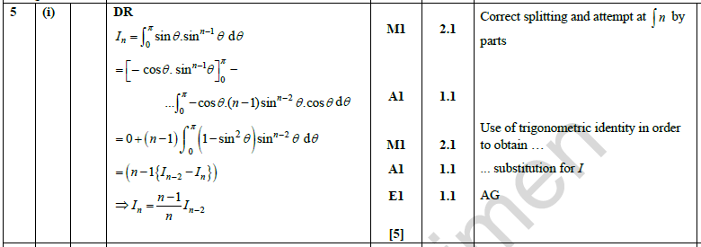
In part (i), candidates should recognise that this is a reduction formula (topic 8.06a) – effectively, a recurrence relation or sequence involving integrals. In almost all cases (occasionally, one can be established directly) this involves the use of integration by parts, a standard method from the Mathematics course (topic 1.08i). Unlike questions that may arise in A Level Mathematics, or in the mandatory Pure Core Further Mathematics papers, the two parts may not always be immediately apparent, especially as the purpose of a reduction formula is to organise the parts so that a second integral, of the required form but (in some way) of lower degree, is obtained. A very swift analysis suggests that there are only the three likely candidates for integrating sin^{n}x, and these are
sin^{n}x × 1
sin^{n–1}x × sin x
sin^{n–2}x × sin²x
Experience in handling such questions should lead candidates to recognise that the middle option has a differentiable first ‘part’ (hinted at with the factor of (n – 1) appearing in the given reduction formula) and an integrable second ‘part’.

Slide 10
Part (ii) (a) – even though it is only for 2 marks – still requires candidates to adhere to the 'detailed reasoning' requirement, so an answer-only response will be given no credit. A moment’s thought on the candidate’s part will suggest that it is not a demanding integration. A further thought might make a shrewd (or suspicious) candidate ask why are we ‘setting the ball rolling’ with n = 1 when the original wording seems to allow for n = 0. This is actually a very good question. It is obvious that the reduction formula is 'second-order', in the sense that each term is somehow related to the term two steps down the line (jumping the intermediate term in this case), so the demand of (ii) (a) suggests that the process is set-up to deal with odd-numbered terms only.
In (ii) (b), we then see that this is the case, once one has replaced cos² by 1 – sin² and then split the given integral up as the difference
I₅ – I₇ . This final part of the question must be completed using the reduction formula, and is only allocated the 2 marks, so it is simply a case of plugging it all in and working it through.

Slide 11
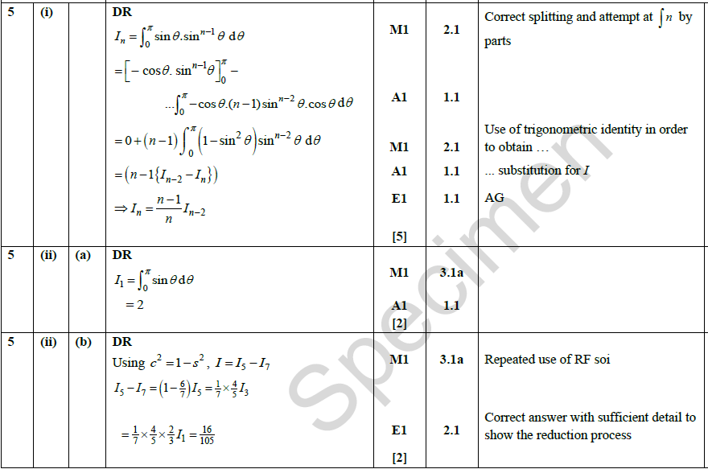
The introductory command phrase 'In this question you must show detailed reasoning' stands out, and not just because it is emboldened. The specification guidance regarding this phrase is quite careful: candidates must give a solution which leads to a conclusion showing a detailed and complete analytical method. Their solution should contain sufficient detail to allow the line of their argument to be followed. Candidates must be aware that, at any stage of the question, a lack of clarity may lead to the loss of some or all of the marks. Even those outstanding candidates who are capable of processing several steps 'in their head' must still make the effort to demonstrate clear individual steps of working.
One final point is worth making here, regarding the 'detailed reasoning' demand, and it relates to the specification guidance, which continues with: This is not a restriction on a learner’s use of a calculator when tacking the question, e.g. for checking an answer or evaluating a function … . A candidate with a suitable graphing calculator should be able to check the numerical accuracy of their analytically-found answer in just a few seconds and all candidates should realise that they can use their calculator to multiply some fractions together (as here). It is the processes that lead to the correct answer, and not the mental or pen-and-paper calculations, that are being required of them.

Slide 12
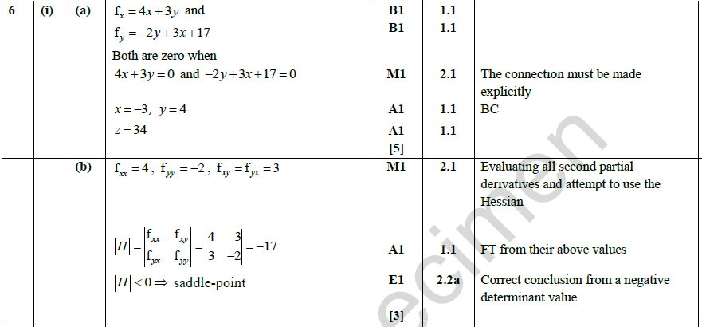
The command word 'determine', which appears in both parts of (i), indicates that justification should be given for any results found, including working where appropriate. It is important for candidates to realise the significance of these command words and phrases which appear throughout the papers.
To begin with, there is a clear statement that the given surface has a single stationary point, so any working that seems to suggest more has obviously gone astray. Otherwise, parts (i) are fairly routine in their demand, though not necessarily in their execution; as we are beginning to get 'well into' the paper, the technical demands must be expected to increase the further on one goes. The first hurdle is that there are two partial first-derivatives to be set to zero, though all candidates should be comfortable with dealing with simultaneous equations by this stage of their mathematical careers.
In (i) (b), the evaluation of the determinant of the so-called Hessian matrix is the required procedure (topic 8.05f) and the interpretation of the ensuing numerical answer is also clearly outlined therein.

Slide 13
Part (ii) also involves a routine application of the result of section 8.05g – regarding tangent-planes. This is much easier to recall if one realises that it is an extension into 3-dimensions of the 2-dimensional result for lines:
y – y-coordinate = (gradient).(x – x-coordinate)
becoming
z – z-coordinate = (x-gradient).(x – x-coordinate) + (y-gradient).(y – y-coordinate).

Slide 14
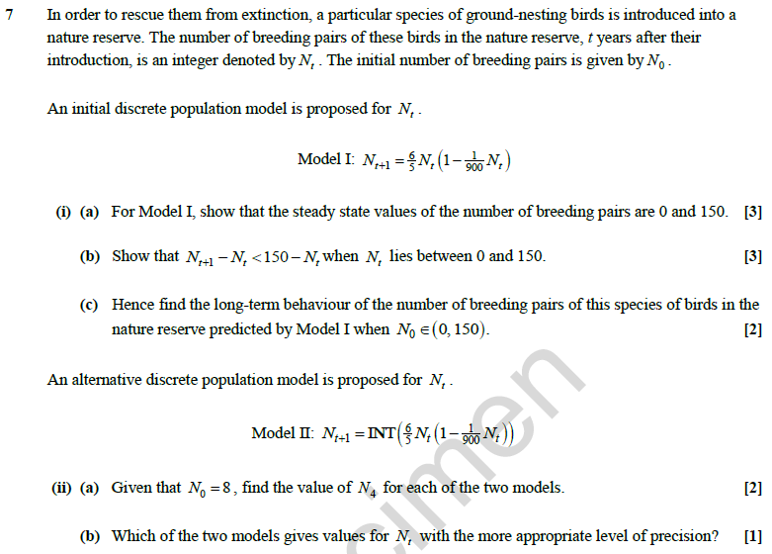
This is a modelling question, in which you get to deploy your pure mathematical skills in a contextual setting. In addition to whichever of the specification topics are involved in the given context, there may be a need to develop a quick grasp of the situation that is being described, and this is (in itself) a very tricky thing to achieve in a short space of time. For that reason, the chosen setting should be one for which it IS possible to appreciate what is going on without either a great deal of prior knowledge, nor should it be the case that large amounts of reading time, or other time spent in grappling with the ideas, are required.

Slide 15
Stripping away the setting, this question involves first-order recurrence relations (topic 8.01h). Notice that the term on the right-hand-side of Model I is quadratic in nature, so there are no immediate hurdles to coming to terms with the situation.
In (i) (a), all that is required is to note that, for a stable population, all Ns are equal, irrespective of the subscript. This gives a quadratic equation with an obvious factor of N throughout, leading to the required zero 'steady state'.
A common mistake would be to not give the final line, or to only state M = 150, but both need to be explicitly stated since the question has specifically asked for this to be shown.

Slide 16
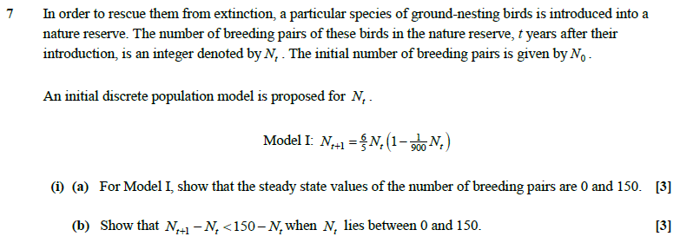
In (i) (b), there is a bit of algebra to be performed and it is (again) important to note explicitly that (150 – N_{t}) is a positive quantity. Then, simply subtract N_{t} from the given expression for N_{t + 1} and make sure that you are careful with the direction of any inequality signs and statements. (Remember what was said earlier about the command 'show that'.)

Slide 17
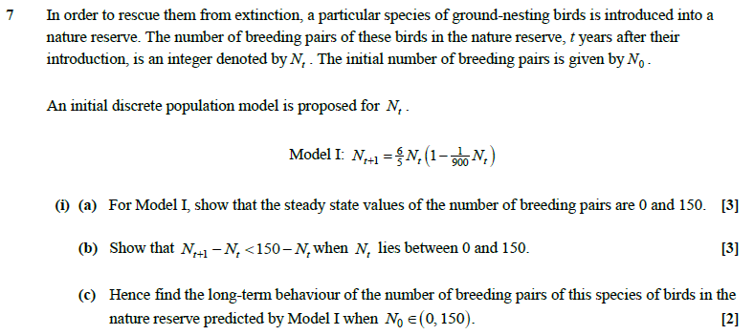
Part (i) (c) is actually rather tricky, in the sense that it represents the first point in this question at which you simply cannot proceed 'on automatic' but will have to think about things a bit. However, you should have studied questions and contexts of this kind as you worked through the various topics in the specification. All candidates are expected to have a calculator which performs operations on sequences, or at least one in which it is possible to repeatedly enter the previous output to see what happens as this iterative process runs on. This button-pressing exercise will show you what happens in the long run (though you will, of course, have to choose your own starting-points). You will see that, for any starting-point in the interval (0, 150), the process converges to 150, increasing at each step. Using the result of part (b) to explain this is all about using the fact that one gap is smaller than another gap.

Slide 18
The second model is also worthy of further exploration. For starters, you should have a calculator with the INT function available on it; if not, then try playing around with this second model’s equation on a spreadsheet. The INT function simply takes the integer part of a number (though take care when dealing with negative numbers as the INT and INTG functions deal slightly differently with them). In this case, you will find that the convergence is slightly different; since any decimal part gets eliminated at each step, the stable solution turns out to be only 145. Without an INT function, (ii) (a) can still be answered in the examination, as the necessary roundings can be performed for a few steps of the second process. Of course, it is precisely this sort of difference between the two models that is the key to (ii) (b), since decimal parts aren’t suitable in a discrete situation.

Slide 19
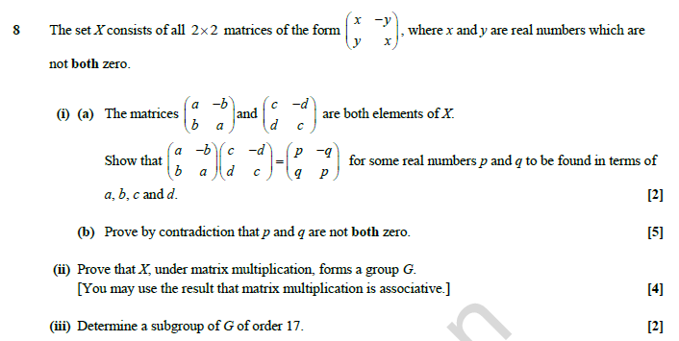
This groups question covers several elements of specification topic 8.03 as well as being couched in terms of matrices (Further Maths Pure Core topic 4.03), so there is already the likelihood that this question might be more than routinely demanding, especially as the matrices are non-numerical and the set of infinite order.

Slide 20
Part (i) (a) is straightforward algebraic work.

Slide 21
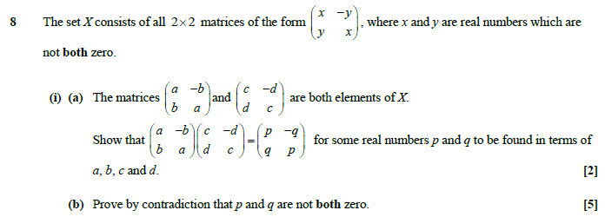
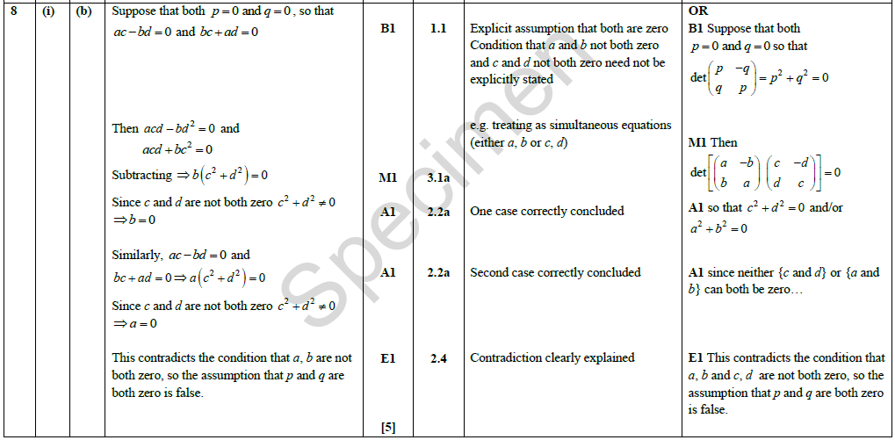
Part (i) (b) requires proof by contradiction which, while simple enough in principle, is not something that gets asked for very often, even though the handling of 'proof' is one of the Overarching Themes (OT1.5) across the whole of the reformed GCE mathematics criteria AND the fact that 'proof by contradiction' was introduced in topic 1.01d of A level Mathematics. This is partly because good examples are hard to manufacture. In this instance, matters are complicated because either of a or b are allowed to be zero, just not both of them.
To begin with, there should be a clear statement that both p and q ARE zero, and it is helpful to observe what that means in terms of a and b (and hold in mind that, lurking in the background, we have that not both of a, b are zero AND not both of c, d are zero). Then, solving for a, b in terms of c, d ( or vice versa) leads to a suitable contradiction.

Slide 22
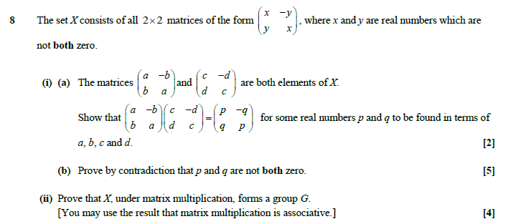
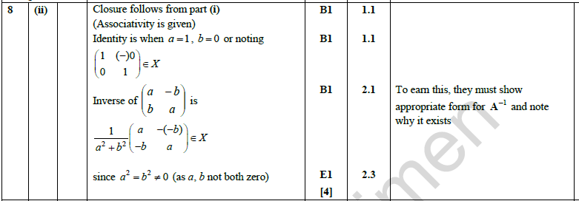
Part (ii) should find us back on more familiar territory with groups work, establishing that a set of elements, together with a binary operation, form a group (topics 8.03a and 8.03c), even though the 'order' of the group is clearly infinite (topic 8.03j). To begin with, (i) (b) actually established the property of Closure. Then, as is customarily the case, the operation – which is merely matrix multiplication and hence 'known' to be associative – is a given, leaving candidates to figure out the identity matrix (for which the usual matrix I is an obvious choice) and the inverse of any given matrix … again, there is a standard (and quotable) 'write-down' candidate available (Pure Core topic 4.03n).
However, what is easy to overlook here is that one must still demonstrate how it is that the offered identity and inverse genuinely ARE elements of the given set; that is, that they are indeed of the required
form.
It is, therefore, not enough merely to state the identity and inverse matrices.

Slide 23
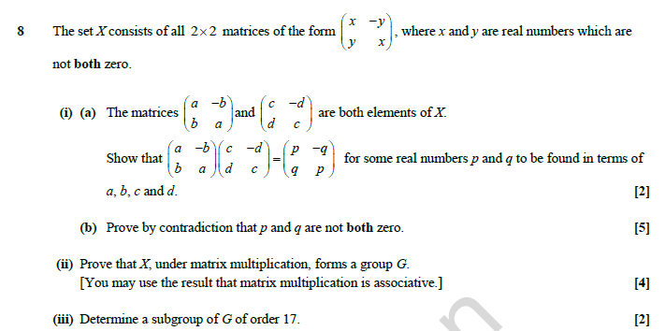
Part (iii) involves another 'think about it' part at the end of a question. Subgroups (topic 8.03f) are generally quite obvious but this one requires the candidates to think about the sorts of things they know about matrices; and the '17' – while actually irrelevant in some respects – is sufficiently different to force the solver to do so. In this case, the work for the Pure Core paper covers (topic 4.03d) the
2 × 2 matrices for rotations, which ARE of the form required, but with trig. Angles related to

Slide 24
This is the final question on the paper and one sees straight away that it carries rather a lot of marks. Moreover, it is on one of the completely new topics, namely Number Theory (8.02). Having said that, many of the ideas have been seen throughout KS3 and KS4 (primes, divisibility, remainders, etc.) and a major part of the problems found by students encountering this area at a formal level revolves around the issue of what may be taken as 'obvious' and what needs to be explained, proved or justified.

Slide 25
The questions begins with a fairly simple idea (which most candidates would, hopefully, have seen before) that all primes p > 3 satisfy the condition p ≡ ± 1 (mod 6). Note that the possible residues modulo 6 are 0, 1, 2, 3, 4 and 5 or, alternatively, 0, ± 1, ± 2 and 3. It is of no significance whatsoever which of these two forms is used, but candidates do need to be confident working with either/both as need requires. The simplest approach to the proof wanted in (i) (a) need be no more 'in depth' than to eliminate the other four possibilities:
p ≡ 0 ⇒ p is divisible by 6, and hence not prime
p ≡ 2 ⇒ p is even (and greater than 2), hence not prime
p ≡ 3 ⇒ p is divisible by 3 (and greater than 2), and hence not prime
p ≡ 4 ⇒ p is even, and hence not prime.
For (i) (b), the hint is to use (a)’s result to write
p = 6k ± 1
and then do the algebra.

Slide 26
One could well be forgiven for spending a moment or two wondering if part (ii) relies on the result of part (i), but candidates should have the experience to recognise that this result looks an awful lot like the result known as Fermat’s little theorem (FLT) (topic 8.02l) and the problem then falls to a bit of indices work, with the target being to
work into something to do with . Notice, again, the presence of the command word 'determine', requiring
justification and working where appropriate. If in doubt, it is always best to say why you think something you have stated is applicable. This last idea is illustrated immediately since, in order to apply FLT in the form
a^{p – 1} ≡ 1 (mod p), the first of the two forms given in the specification , one requires that hcf(a, p) = 1 … which holds here since a = 2 is prime and p is a prime > 3.

Slide 27
In part (iii), FLT is again applied to a situation with two distinct primes, this time called p and q. It is not easy to see how the result can be established mod pq, but very easy to see that it can be established, individually, mod p and then mod q. Since p and q are co-prime, the bigger result follows immediately. If in doubt, think about the statement that the number X leaves a remainder of 1 upon division by 5 and that X also leaves a remainder of 1 upon division by 6. This can only happen when X ≡ 1 (mod 5 × 6 = 30).

