Slide 1
H070 Topic Title
H470 Topic Title

Slide 2
Guide to the A Level Geography Assessment Objectives

Slide 3
About this guide
This guide is designed to give you a better understanding of the three A Level Geography assessment objectives.
This guide will explain the key points for each assessment objective.
This guide shows examples of the different types of exam questions and how assessment objectives are allocated to them.
The three assessment objectives are the same for AS Geography but this guide will be specific to A Level Geography in its comments.

Slide 4
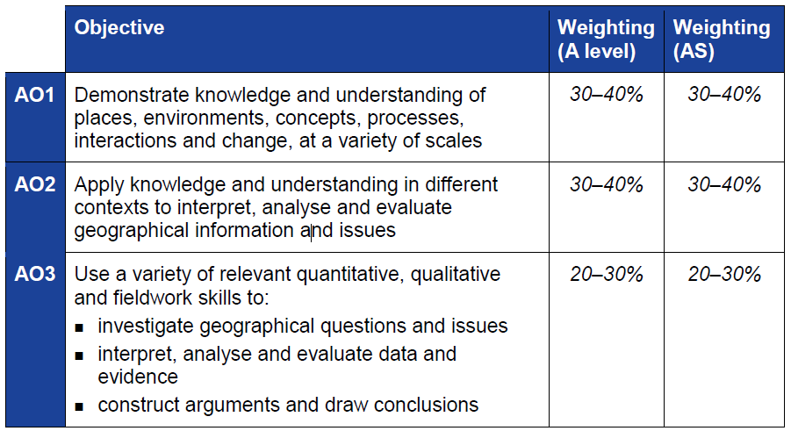
The Three Assessment Objectives (AOs)
The assessment objectives are vital when understanding the assessment and are set by Ofqual. For A Level Geography there are thee Assessment Objectives – AO1 (Knowledge and Understanding), AO2 (Application of knowledge and understanding) and AO3 (Skills).
34% of the A Level Geography qualification
marks will be allocated to assessing students’ knowledge and understanding (AO1)
38% of the A Level Geography qualification
marks will be allocated to assessing students’ application of their knowledge and understanding (AO2)
28% of the A Level Geography qualification
marks will be allocated to assessing students’ ability to use a variety of quantitative, qualitative and fieldwork skills (AO3)
AS
AO1 | 39%
AO2 | 36%
AO3 | 25%
We have made sure there is a difference between the AS and A Level assessment objective allocations.
A Level
AO1 | 34%
AO2 | 38%
AO3 | 28%

Slide 5
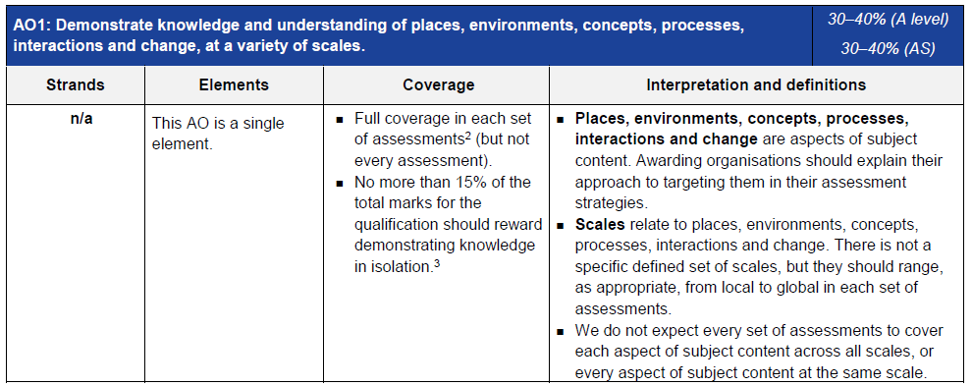
AO1 - Knowledge
Each year across the range of assessments there must be knowledge marks for locations, places, processes, environments and different scales but AO1 marks do not have to be included in every assessment.
Places, environments, concepts, processes, interactions and change simply cover the subject content. There are other ways which you may describe content areas but all must be placed in these four aspects when we are creating our assessments.
The number of marks available for students to just recall information is limited to 15%
Each year assessments will cover different scales from local to global but not for every bit of content or necessarily for all of locations, places, processes and environments.

Slide 6
AO1 command words
AO1 requires students to demonstrate knowledge and understanding of the specification content, recalling information – including in a case study context.
Questions which target AO1 alone would tend to be shorter answer questions but longer questions may have AO1 marks allocated to them as well when combined with another assessment objective – particularly with AO2.
Questions with AO1 marks will require knowledge and understanding – although there may be some marks available for simple recall of information within questions.
‘Explain’ is the most common command word which requires students to just show knowledge and understanding.
Knowledge and understanding will also be required in all ‘essay’ questions of 16 marks and above (where quality of extended response is considered).

Slide 7
What are AO1 marks?
AO1 marks are given in questions where students need to show knowledge and understanding of elements of content directly from the specification. This includes when there is a case study focus within the question. Questions with a case study focus, and where there are higher mark tariff questions where case study information would be expected to be included as appropriate, would always include AO1 marks.
The examples above are examples of questions where all of the marks are allocated to AO1. The wording of the questions mirror the aspect of the specification they are assessing and so this question can be answered purely with knowledge and understanding learnt during the teaching of the specification.
The examples below are questions which include marks for knowledge and understanding (AO1), as well as marks for application of knowledge and understanding (AO2). The top example requires knowledge and understanding of the factors responsible for gender inequalities, including social factors. The bottom example requires knowledge and understanding of factors that influence the spread of disease.

Slide 8
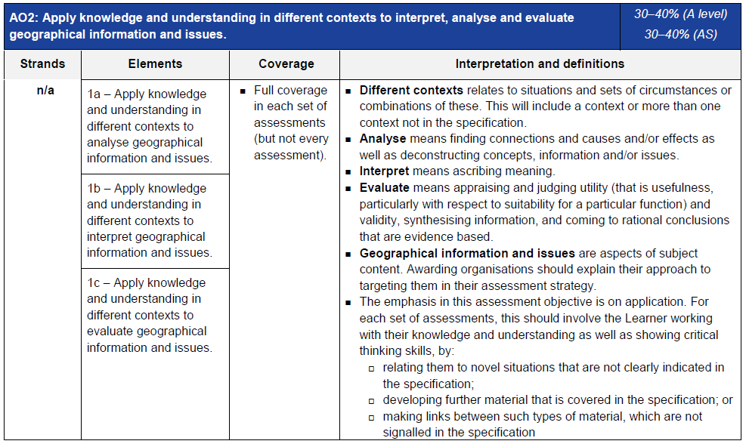
AO2 - Application
Definitions of analyse, interpret and evaluate in the context of A Level examinations
Geographical information and issues are just aspects of subject content
Three ways that students will need to apply their knowledge and understanding:
‘relating to novel situations that are not clearly indicated in the specification’ could mean applying knowledge and understanding to a resource
‘developing further material that is covered in the specification’ could be examining the significance of the role of things when the specification doesn’t explicitly ask for that
‘making links between such types of material which are not signalled in the specification’ could be synoptic questions.

Slide 9
AO2 command words
Command words will vary depending on whether students are applying their knowledge and understanding by interacting with a resource(s) or not.
The following are some of the command words which may be used for questions with AO2 marks:
Weigh up whether a statement is true.
Interacting with resource | No resource
Explain | Assess
Analyse | Examine
Suggest | How far do you agree
Describe | To what extent do you agree
Look in close detail and establish the key facts and important issues.
How far you agree with a statement based on evidence
How much you agree with a statement based of the evidence in argument.

Slide 10
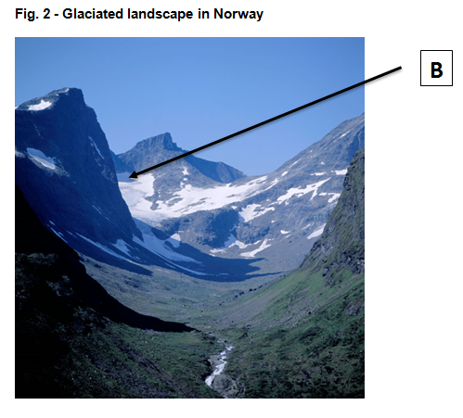
AO2 - Application
Students will need to apply their knowledge and understanding in three different ways:
‘relating to novel situations that are not clearly indicated in the specification’ could mean applying knowledge and understanding to a resource
‘developing further material that is covered in the specification’ could be assessing the relative importance of things when the specification doesn’t explicitly ask for that
‘making links between such types of material which are not signalled in the specification’ could be synoptic questions.
Firstly, applying their knowledge and understanding to tackle novel situations that are not clearly indicated in the specification.
This question is an example of this; students should know about how geomorphic processes influence the formation of landforms but this question is asking students to apply what they know to the resource to interpret the resource.

Slide 11
AO2 - Application
Secondly, applying their knowledge and understanding to develop further material that is covered in the specification.
This question requires students to develop what they know to be able to apply their knowledge and understanding to analyse the significance of the role of vegetation in linking the water and carbon cycles. Within this question there are also marks for knowledge and understanding of the role of vegetation in linking the water and carbon cycles.

Slide 12
AO2 - Application
Thirdly, applying their knowledge and understanding to make links between such types of material which are not signalled in the specification.
The question above is an example of a question where students have to make links which are not explicitly signalled in the specification.
This is a synoptic question – the questions require students to draw together knowledge and understanding from two different topics within the specification. Synoptic questions are assessed in Section B of Component 3 ‘Geographical Debates’.

Slide 13
What are AO2 ‘analyse’ marks?
Analyse means finding connections and causes and/or effects as well as deconstructing concepts, information and/or issues.
Marks allocated to the ‘application of knowledge and understanding to analyse’ could be found in questions of all sizes from short answer questions to higher tariff extended response questions. There will always be analyse marks in higher tariff extended response questions.
The two questions on this slide both have marks allocated to AO2 ‘analyse’. In each case students need to apply their knowledge and understanding to do some or all of: find connections and causes and/or effects as well as deconstructing concepts, information and/or issues (Ofqual wording) as a requirement of ‘analyse’.
The first question is a three mark question where all of the marks are allocated to analyse as answers require students to find connections and/or causes for the spatial variations in Fig. 3. There is a mark for the factor and two further marks for explaining the factor.
The second question has analysis marks as part of the AO2 level descriptor (there are also marks allocated for students to evaluate) in order for students to analyse of how imbalances in global food production impact people and the environment. This will require students to deconstruct concepts, information and/or issues, as well as potentially finding connections and causes and/or effects.

Slide 14
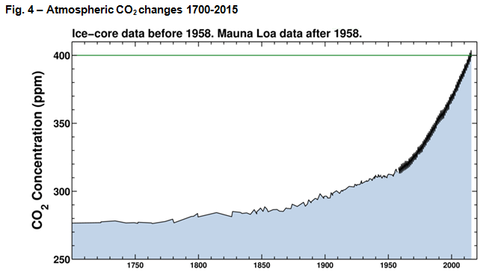
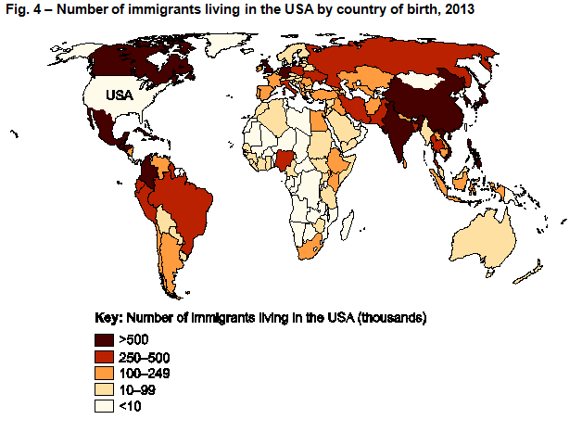
What are AO2 ‘interpret’ marks?
The two questions on this slide have their marks which are allocated as AO2 ‘interpret’.
In each case students need to apply their knowledge and understanding to ascribe meaning (Ofqual wording) as a requirement of ‘interpret’. In these examples information is interpreted from an unseen resource in order to answer the questions.
Both questions include ‘shown in Fig. 4’ which indicates that there must be interaction with the resource when students interpret the resource to answer the questions.

Slide 15
What are AO2 ‘evaluate’ marks?
Evaluate means appraising and judging utility (that is usefulness, particularly with respect to suitability for a particular function) and validity, synthesising information, and coming to rational conclusions that are evidence based.
As with ‘analyse’, marks allocated to the ‘application of knowledge and understanding to evaluate’ could be found in questions of all sizes from short answer questions to higher tariff extended response questions. There will always be evaluate marks in higher tariff extended response questions.
The question on this slide has marks allocated to AO2 ‘evaluate’. In this case students need to apply their knowledge and understanding to do some of or all; appraising and judging utility and validity, synthesising information, and coming to rational conclusions that are evidence based (Ofqual wording) as a requirement of ‘evaluate’.
The question below has evaluate marks as part of the AO2 level descriptor (there are also marks allocated for students to analyse as well for AO1 knowledge and understanding) in order for students to evaluate whether increased global mobility is the most important influence on the spread of communicable diseases. This will require students to appraise and judge the utility and validity of the statement, synthesise information and come to a rational conclusion that is evidence based.

Slide 16
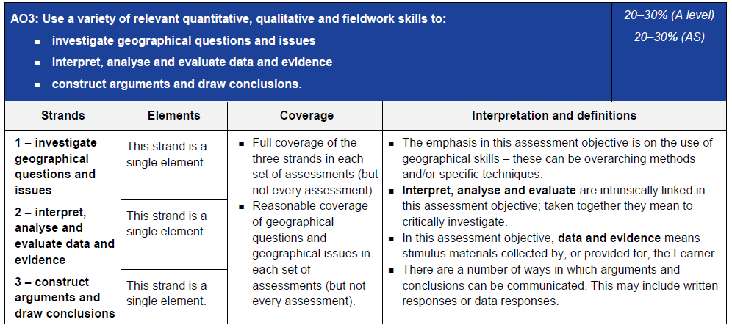
AO3 - Skills
Data and evidence means stimulus materials (e.g. unseen resources in a resource booklet)
Emphasis of assessment objective is on the use of geographical skills – overarching methods (e.g. quantitative skills) and/or specific techniques (e.g. standard deviation)
The majority of AO3 (skills) marks are allocated to the non-exam assessment (60 out of 84 total AO3 marks) but there are AO3 marks in every assessment.

Slide 17
AO3 command words
AO3 requires students to use a variety of relevant quantitative, qualitative and fieldwork skills, in order to:
investigate geographical questions and issues
interpret, analyse and evaluate data and evidence
construct arguments and draw conclusions.
The following are some of the command words which may be used for questions with AO3 marks:
Identify
Suggest how
Explain
Calculate
Command words may vary depending on the level of interaction with a resource.

Slide 18
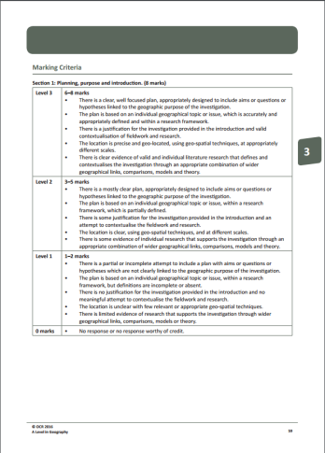
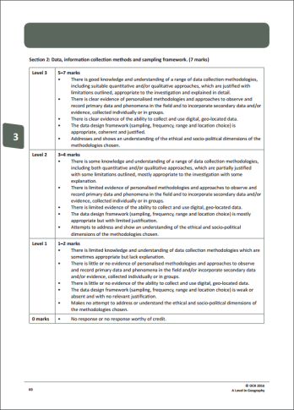
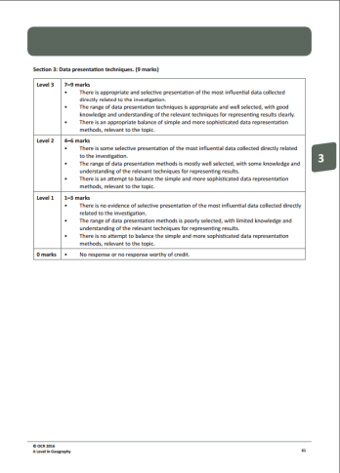
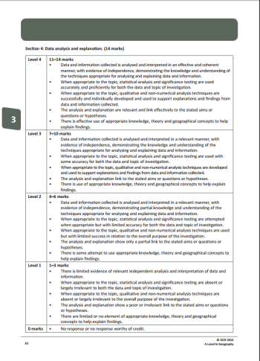
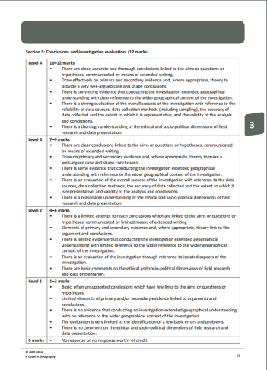
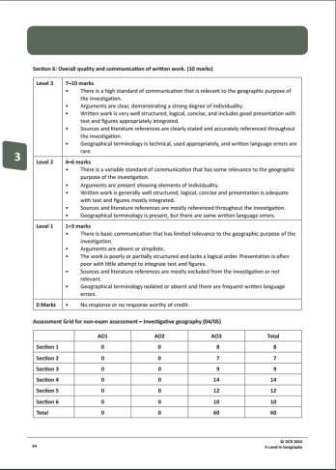
AO3 - Skills
AO3 requires students to use a variety of relevant quantitative, qualitative and fieldwork skills, in order to:
investigate geographical questions and issues
interpret, analyse and evaluate data and evidence
construct arguments and draw conclusions.
Both of ‘investigating geographical questions and issues’ and ‘construct arguments and draw conclusions’ are wording which link heavily to fieldwork. Therefore these are covered within the mark scheme for the Independent Investigation non-exam assessment (Component 4 – ‘Investigative Geography’). The mark scheme for the Independent Investigation can be found on pages 59-64 of the specification.

Slide 19
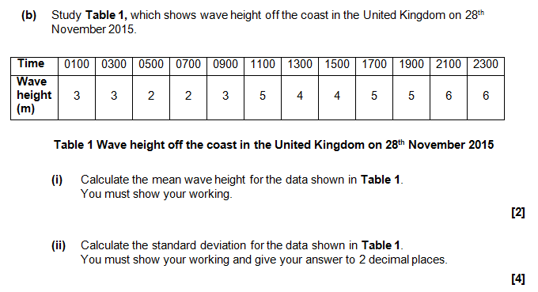
AO3 - Skills
AO3 requires students to use a variety of relevant quantitative, qualitative and fieldwork skills, in order to:
investigate geographical questions and issues
interpret, analyse and evaluate data and evidence
construct arguments and draw conclusions.
Interpreting, analysing and evaluating data and evidence is wording which requires stimulus material –provided through unseen resources.
All of the questions which require interpret, analyse and evaluate data and evidence have interaction with a resource (data from a table, photo, graph, etc.) and specify in the question that the resource must be used.

