Slide 1
H070 Topic Title
H470 Topic Title

Slide 2
Guide to the SAMs
Component 3 –
Geographical debates

Slide 3
H481/03 Geographical debates
The Geographical debates (03) component takes some of the most dynamic issues the planet faces and encourages learners to engage with, reflect on and think critically about them. Learners will gain a deep understanding of their two chosen topics, exploring the interactions between people and the environment. There are five topic options (Climate Change, Disease Dilemmas, Exploring Oceans, Future of Food and Hazardous Earth) for learners to choose from in the Geographical debates (03) component. Learners must choose two options out of the five.
But what will the assessments look like?
This guide will give you an understanding of the format and structure of the exam, an insight into the assessment objectives and a question by question explanation of the sample assessment for H481/03 Geographical debates. This guide can also be used with your students to support revision.

Slide 4
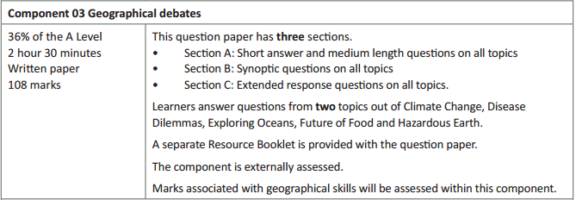
How will Geographical debates be assessed?
150 minutes for 108 marks – more than a minute per mark
Three sections to the question paper. Students answer questions in each section on their two chosen geographical debate topics
A separate Resource Booklet so students can access resources easily when answering questions.
6 marks for AO3 (skills)

Slide 5
How will Geographical debates be assessed?
The overall exam will be out of 108 marks with 2 hours 30 minutes to complete the exam (over a minute per mark).
The Assessment Objective breakdown for the overall paper is:
There are three sections to Geographical debates (of which students answer questions on two options in each section):
Section A which includes short and medium length questions on all topics.
Section B which includes synoptic questions on all topics.
Section C which includes extended response questions on all topics.
But let’s have a look at the three sections in more detail on the following slides.
 | AO1 (Knowledge and understanding) | AO2 (Application) | AO3 (Skills) | Total
Marks | 42 | 60 | 6 | 108

Slide 6
Geographical debates - Section A
Section A of the Geographical debates assessment contains optionality of topics, with students answering both parts of the question for the two different topics they have studied. There are 9 marks per topic in this section of the exam.
This section there will be in each option:
one low tariff, 3 mark question, which is point marked, targeting AO3 marks
one medium length, 6 mark question targeting AO1 marks.
In Section A there will only be AO1 and AO3 marks allocated to the questions – there will be no AO2 marks in this section.
The totals reflect that students answer questions on two topics in Section A.
This question structure will be the same in future assessments.
 | AO1 (Knowledge and understanding) | AO2 (Application) | AO3 (Skills) | Total
Marks | 12 | 0 | 3 | 18

Slide 7
Geographical debates - Section B
Section B of the Geographical debates assessment contains optionality of topics, with students answering the question for the two different topics they have studied. There are 12 marks per topic in this section of the exam.
This section will include one synoptic medium length question (12 marks) per option.
In Section B there will only be AO1 and AO2 marks allocated to the questions – there will be no AO3 marks in this section.
The totals reflect that students answer questions on two topics in Section B.
This question structure will be the same in future assessments.
 | AO1 (Knowledge and understanding) | AO2 (Application) | AO3 (Skills) | Total
Marks | 12 | 12 | 0 | 24

Slide 8
Geographical debates - Section C
Section C of the Geographical debates assessment contains optionality of topics, with students answering one question from two different topics they have studied. There are 33 marks per topic in this section of the exam.
This section will include high tariff essay questions (33 marks) of which students answer one question from a choice of two, for two different options.
In Section C there will only be AO1 and AO2 marks allocated to the questions – there will be no AO3 marks in this section.
The totals reflect that students answer questions on two topics in Section C.
This question structure will be the same in future assessments.
 | AO1 (Knowledge and understanding) | AO2 (Application) | AO3 (Skills) | Total
Marks | 18 | 48 | 0 | 66

Slide 9
Quality of Extended Responses
‘Quality of extended response’ is assessed within each level for questions of 16 marks or above and is indicated by an asterisk (*) beside the question. The following are the descriptors placed within the levels for 33 mark questions:
Level 4
There is a well-developed line of reasoning which is clear and logically structured. The information presented is relevant and substantiated.
Level 3
There is a line of reasoning presented with some structure. The information presented is in the most-part relevant and supported by some evidence.
Level 2
The information has some relevance and is presented with limited structure. The information is supported by limited evidence.
Level 1
The information is basic and communicated in an unstructured way. The information is supported by limited evidence and the relationship to the evidence may not be clear.
The way that a student has structured their response would need to be considered when you are deciding which level to place the student in – but the quality of the geographical content within the answer should always be the most important consideration.

Slide 10
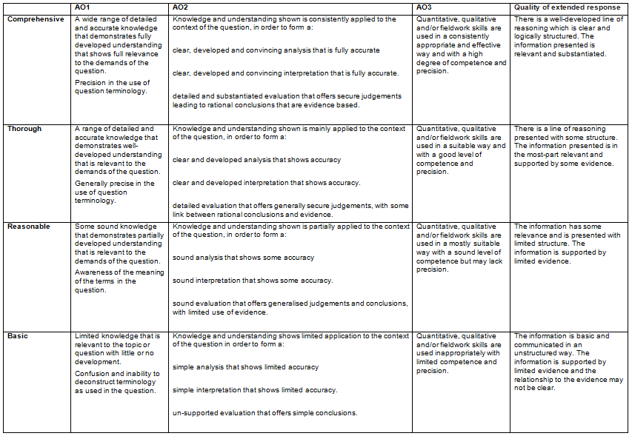
Level of Response Questions Marking Guidance
At the beginning of each mark scheme the following table is included to help you understand the level of response mark schemes – this is for any level marked questions (6 marks and above). The wording in each level (from basic to comprehensive) indicates how answers develop and progress within each assessment objective.

Slide 11
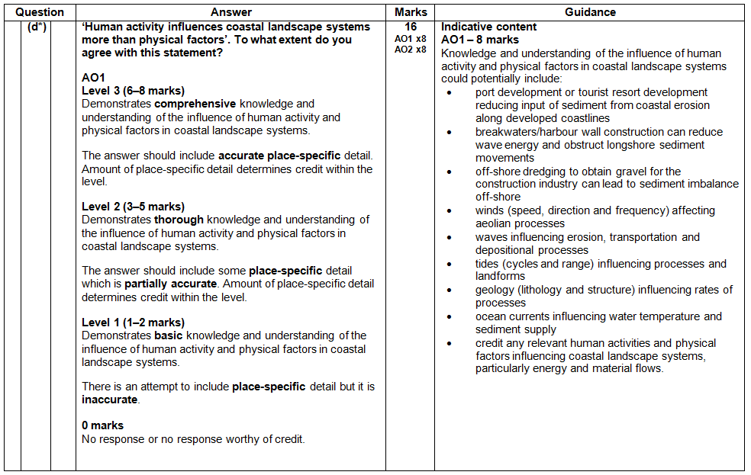
Level of Response Question Mark Scheme
The ‘Answer’ column includes information on how the assessment objectives link to the question and the standard required for the question parts.
The ‘Indicative content’ part of the mark scheme shows some of the content which could be included in students’ answers. This is not an exhaustive list.
A statement to indicate the level of development for answers to reach each level – the wording in the level descriptors are from the marking guidance on slide 10.
In the ‘Guidance’ column there are examples of information that students could discuss in their answers, split by assessment objective.
The list is not exhaustive and students should be rewarded for any appropriate content in their answer.
If ‘Quality of Extended Responses’ and/or ‘place-specific detail’ are being assessed they will be shown in the answer column (Quality of Extended Responses information will be after the AO2 criteria).

Slide 12
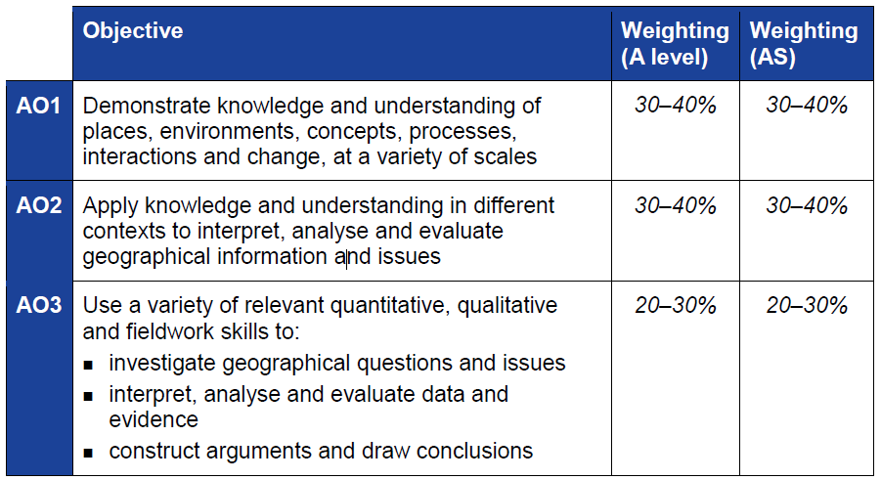
The Three Assessment Objectives (AOs)
The assessment objectives are vital when understanding the assessment and are set by Ofqual. For A Level Geography there are three Assessment Objectives – AO1 (Knowledge and understanding), AO2 (Application of knowledge and understanding) and AO3 (Skills).
34% of the A Level Geography qualification
marks will be allocated to assessing students’ knowledge and understanding (AO1)
38% of the A Level Geography qualification
marks will be allocated to assessing students’ application of their knowledge and understanding (AO2)
28% of the A Level Geography qualification marks will be allocated to assessing students’ ability to use a variety of quantitative, qualitative and fieldwork skills (AO3)

Slide 13
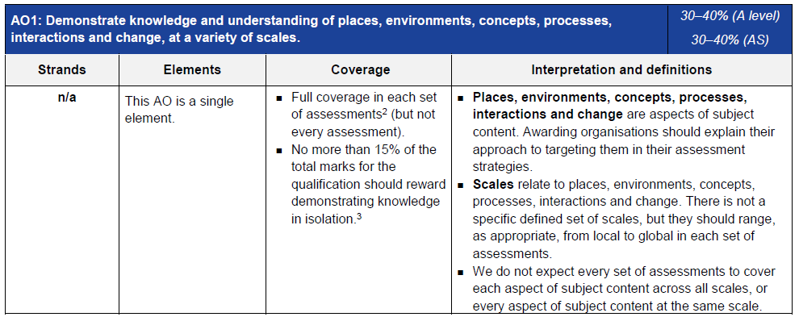
AO1 – Knowledge and understanding
Each year across the range of assessments there must be knowledge and understanding marks for locations, places, processes, environments and different scales but AO1 marks do not have to be included in every assessment.
Places, environments, concepts, processes, interactions and change simply cover the subject content. There are other ways which you may describe content areas but all must be placed in these six aspects when we are creating our assessments.
The number of marks available for students to just recall information is limited to 15%
Each year assessments will cover different scales from local to global but not for every bit of content or necessarily for all of places, environments, concepts, processes, interactions and change.

Slide 14
AO1 command words
AO1 requires students to demonstrate knowledge and understanding of the specification content, recalling information – including in a case study context.
Questions which target AO1 alone would tend to be shorter answer questions but longer questions may have AO1 marks allocated to them as well when combined with another assessment objective – particularly with AO2.
Questions with AO1 marks will require knowledge and understanding – although there may be some marks available for simple recall of information within questions.
‘Explain’ is the most common command word which requires students to just show knowledge and understanding.
Knowledge and understanding will also be required in all ‘essay’ questions of 16 marks and above (where quality of extended response is considered).

Slide 15
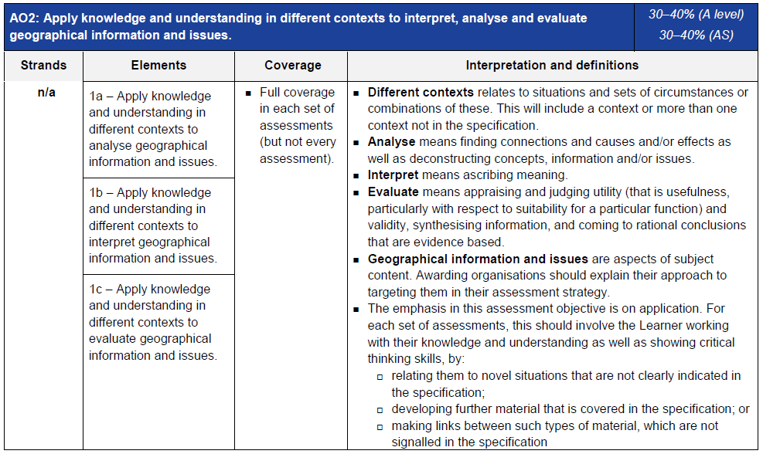
AO2 - Application
Definitions of analyse, interpret and evaluate in the context of A Level examinations
Geographical information and issues are just aspects of subject content
Three ways that students will need to apply their knowledge and understanding:
‘relating to novel situations that are not clearly indicated in the specification’ could
mean applying knowledge and understanding to a resource
‘developing further material that is covered in the specification’ could be assessing
the relative importance of things when the specification doesn’t explicitly ask for that
‘making links between such types of material which are not signalled in the
specification’ could be synoptic questions.

Slide 16
AO2 command words
Command words will vary depending on whether students are applying their knowledge and understanding by interacting with a resource(s) or not.
The following are some of the command words which may be used for questions with AO2 marks:
Weigh up whether a statement is true.
Interacting with resource | No resource
Describe | Assess
Analyse | Examine
Suggest | How far do you agree
Outline | To what extent do you agree
Look in close detail and establish the key facts and important issues.
How far you agree with a statement based on evidence.
The extent you agree with a statement based on evidence.

Slide 17
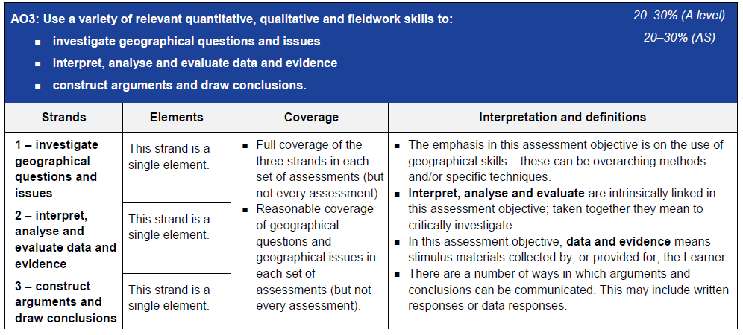
AO3 - Skills
Data and evidence means stimulus materials (e.g. unseen resources in a resource booklet)
Emphasis of assessment objective is on the use of geographical skills – overarching methods (e.g. quantitative skills) and/or specific techniques (e.g. standard deviation)

Slide 18
AO3 command words
AO3 requires students to use a variety of relevant quantitative, qualitative and fieldwork skills, in order to:
investigate geographical questions and issues
interpret, analyse and evaluate data and evidence
construct arguments and draw conclusions.
The following are some of the command words which may be used for questions with AO3 marks:
Compare and contrast
Using evidence from
Suggest
Calculate
Commands words may vary depending on the level of interaction with a resource.

Slide 19
Section A
There is optionality in Section A. Students must answer questions from two options (whichever two topics they have studied).
In the SAMs, Section A had a 3 mark AO3 question and a 6 mark AO1 question for each option.
Every option in Section A will always have an identical structure so that they are comparable.
This will be the same structure as will be used in future examinations.

Slide 20
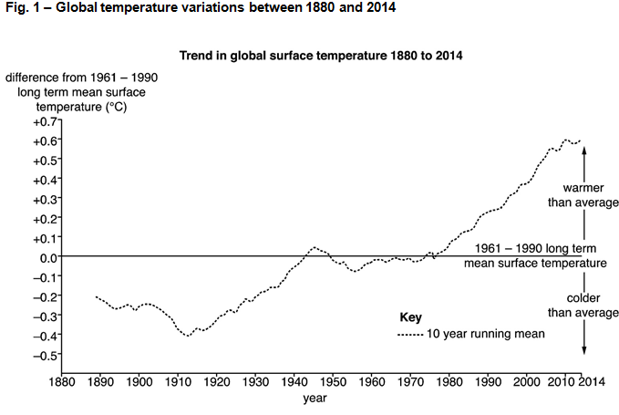
Topic 3.1 – Question 1(a) – 3 marks
Identify three limitations with the data evidence in Fig. 1.
This is a 3 mark question where all marks are allocated to AO3 (skills).
‘Undertake informed and critical questioning of data sources, analytical methodologies, data reporting and presentation’ is stated in the specification (section 4.1 of the geographical skills list in the specification) and this question is directly targeting this skill.
Fig. 1 shows a graph of global temperature variations between 1880 and 2014.

Slide 21
Topic 3.1 – Question 1(a) – 3 marks
Identify three limitations with the data evidence in Fig. 1.
There are three marks available – all for limitations of the data evidence identified through critical questioning of the resource (✓).
Examples of points suggested in the mark scheme include:
The horizontal line showing an approximate 30 year mean (from 1961-1990) gives no indication for why this time period was chosen and the data doesn’t show any striking changes for this period (✓).
The 10 year running mean shows a general pattern of increasing global surface temperatures however this doesn’t show yearly / annual variations which may give a more accurate picture for analysis (✓).
The vertical arrow on the graph identified as ‘warmer than average’ is only compared to the 30 year mean surface temperature not to the whole period of data shown on the graph from 1880 (✓).

Slide 22
Topic 3.1 – Question 1(b) – 6 marks
Explain how shrinking ice sheets show the world has warmed since the late-nineteenth century.
This is a 6 mark question where all marks are allocated to AO1 (knowledge and understanding).
‘Evidence the world has warmed since the late-19th century, including’ is stated in the specification with ‘shrinking of valley glaciers and ice sheets’ (key idea 2.a of this topic).
As this is a level marked question, the answer is not point marked. Therefore the mark a student achieves depends on where they sit in the level mark scheme. Remember there is level of response questions marking guidance to indicate what ‘thorough’, ‘reasonable’ and ‘basic’ mean at the start of the mark schemes (and slide 10 of this presentation).
Level 3 (5–6 marks)
Demonstrates thorough knowledge and understanding of evidence which indicates the world has warmed since the late-nineteenth century (AO1).
This will be shown by including well-developed ideas about evidence which indicates the world has warmed since the late-nineteenth century.
Level 2 (3–4 marks)
Demonstrates reasonable knowledge and understanding of evidence which indicates the world has warmed since the late-nineteenth century (AO1).
This will be shown by including developed ideas about evidence which indicates the world has warmed since the late-nineteenth century.
Level 1 (1–2 marks)
Demonstrates basic knowledge and understanding of evidence which indicates the world has warmed since the late-nineteenth century (AO1).
This will be shown by including simple ideas about evidence which indicates the world has warmed since the late-nineteenth century.

Slide 23
Topic 3.1 – Question 1(b) – 6 marks
Explain how shrinking ice sheets show the world has warmed since the late-nineteenth century.
The ‘Indicative content’ column of the mark scheme gives a number of suggestions of knowledge and understanding which could be incorporated into answers for this question. The list is not exhaustive and students should be rewarded for any appropriate knowledge and understanding shown.
Knowledge and understanding of how shrinking ice sheets show the world has warmed could potentially include:
Greenland (1.7 million km²) Antarctica (14 million km²) have major ice sheets which are experiencing losses due to: ablation, surface melt, calving at ocean interface, melting from ocean contact (significant warming since 1940s, mainly in top 300m)
Polar ice loss has led to 11.1mm of global sea level rise since 1992
Rising sea levels - present day melting of polar ice sheets adds approximately 1mm every year
European space agency monitoring (Cryo-sat 2), enhanced ice sheet monitoring from Nov 2010 to Sept 2013 and found the largest annual losses in Western Antarctica and the Amundsen Sea shows the largest signal of ice loss
Ice sheet loss not just about the world warming but the impact of this warming on oceans which are increasing in temperatures and ocean circulation is altering
Measuring ice sheet loss is much more recent than monitoring of global temperatures. Since late 19th century global surface temperature changes have been approx. 0.6 degrees.

Slide 24
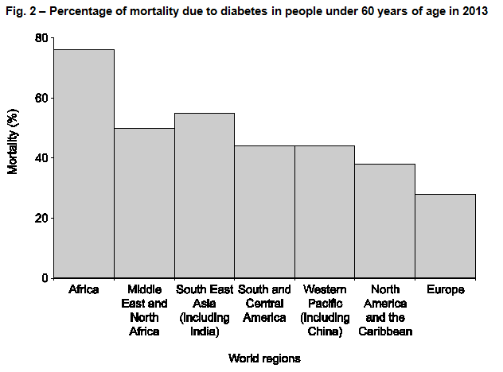
Topic 3.2 – Question 2(a) – 3 marks
Identify three limitations with the data evidence in Fig. 2.
This is a 3 mark question where all marks are allocated to AO3 (skills).
‘Undertake informed and critical questioning of data sources, analytical methodologies, data reporting and presentation’ is stated in the specification (section 4.1 of the geographical skills list in the specification) and this question is directly targeting this skill.
Fig. 2 shows a graph of the percentage of mortality due to diabetes in people under 60 years of age in 2013.

Slide 25
Topic 3.2 – Question 2(a) – 3 marks
Identify three limitations with the data evidence in Fig. 2.
There are 3 marks available – all for limitations of the data evidence identified through critical questioning of the resource (✓).
Examples of points suggested in the mark scheme include:
The continent and world region groupings on the horizontal axis (x-axis) of the graph; are for large areas and shows little variation in mortality percentages to identify any real global differences (✓).
Percentage of mortality includes anyone under the age of 60 years, not allowing for age cohort or gender breakdown which would give a clearer picture of who was most affected by diabetes (✓).
Mortality rates are usually expressed as deaths per 1,000 people per year. However, the graph shows percentage mortality, so data has been converted. Raw data instead of percentages could indicate clearer / large differences in mortality resulting from diabetes (✓).

Slide 26
Topic 3.2 – Question 2(b) – 6 marks
Explain how global patterns of temperature and precipitation affect patterns of disease.
This is a 6 mark question where all marks are allocated to AO1 (knowledge and understanding).
‘Global patterns of temperature, precipitation, relief and water sources and how they affect patterns of disease’ is stated in the specification (key idea 1.b of this topic).
As this is a level marked question, the answer is not point marked. Therefore the mark a student achieves depends on where they sit in the level mark scheme. Remember there is level of response questions marking guidance to indicate what ‘thorough’, ‘reasonable’ and ‘basic’ mean at the start of the mark schemes (and slide 10 of this presentation).
Level 3 (5–6 marks)
Demonstrates thorough knowledge and understanding of how global patterns of temperature and precipitation affect patterns of disease (AO1).
This will be shown by including well-developed ideas about how global patterns of temperature and precipitation affect patterns of disease.
Level 2 (3–4 marks)
Demonstrates reasonable knowledge and understanding of how global patterns of temperature and precipitation affect patterns of disease (AO1).
This will be shown by including developed ideas about how global patterns of temperature and precipitation affect patterns of disease.
Level 1 (1–2 marks)
Demonstrates basic knowledge and understanding of how global patterns of temperature and precipitation affect patterns of disease (AO1).
This will be shown by including simple ideas about how global patterns of temperature and precipitation affect patterns of disease.

Slide 27
Topic 3.2 – Question 2(b) – 6 marks
Explain how global patterns of temperature and precipitation affect patterns of disease.
The ‘Indicative content’ column of the mark scheme gives a number of suggestions of knowledge and understanding which could be incorporated into answers for this question. The list is not exhaustive and students should be rewarded for any appropriate knowledge and understanding shown.
Knowledge and understanding of how global patterns of temperature and precipitation affect patterns of disease, could potentially include:
high temperatures (32 degrees and above) and rainfall in tropical and sub-tropical regions encourages vector borne diseases to thrive such as malaria and dengue fever
In the northern hemisphere with lower temperatures particularly in the winter months and with high precipitation levels this encourages, influenza epidemics and the flu virus
prolonged periods of dry weather and drought conditions (USA, Australia, Africa) contribute to forest / bush fires creating respiratory illness
in tropical areas located close to the equator, influenza outbreaks occur all year where temperature and rainfall is high all year with little fluctuation
in monsoonal areas with peaks of high rainfall and higher temperatures from May to August diarrhoeal disease in South Asia surges
El Niño from late 2014 to early 2015 created regional weather patterns including persistent high temperatures and drought in some areas and heavy rainfall and flooding in others. There were regional infectious disease hotspots due to droughts, floods and tropical cyclones. The temperature and rainfall patterns encourage the transmission of disease such as cholera in Bangladesh or dengue fever in Thailand.

Slide 28
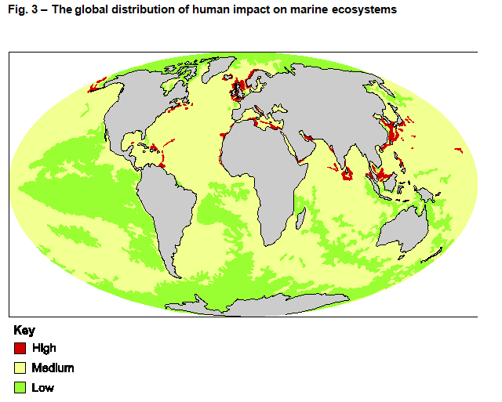
Topic 3.3 – Question 3(a) – 3 marks
Identify three limitations with the data evidence in Fig. 3.
This is a 3 mark question where all marks are allocated to AO3 (skills).
‘Undertake informed and critical questioning of data sources, analytical methodologies, data reporting and presentation’ is stated in the specification (section 4.1 of the geographical skills list in the specification) and this question is directly targeting this skill.
Fig. 3 shows a map of the global distribution of human impact on marine ecosystems.

Slide 29
Topic 3.3 – Question 3(a) – 3 marks
Identify three limitations with the data evidence in Fig. 3.
There are 3 marks available – all for limitations of the data evidence identified through critical questioning of the resource (✓).
Examples of points suggested in the mark scheme include:
The key used on the map gives three general categories of impact with no explanation of what the human impacts on marine ecosystems include (✓).
The impacts have no numerical value or any indication of what data is included to judge the high, medium and low level impacts (✓).
The yellow and green categories (medium and low impacts) cover vast ocean areas. The pattern shown is quite specific, particularly for the green categories with no information on how this was mapped (✓).

Slide 30
Topic 3.3 – Question 3(b) – 6 marks
Explain the global distribution of warm and cold ocean surface currents.
This is a 6 mark question where all marks are allocated to AO1 (knowledge and understanding).
‘The global distribution of warm and cold surface currents’ is stated in the specification (key idea 1.b of this topic).
As this is a level marked question, the answer is not point marked. Therefore the mark a student achieves depends on where they sit in the level mark scheme. Remember there is level of response questions marking guidance to indicate what ‘thorough’, ‘reasonable’ and ‘basic’ mean at the start of the mark schemes (and slide 10 of this presentation).
Level 3 (5–6 marks)
Demonstrates thorough knowledge and understanding of the global distribution of warm and cold ocean surface currents (AO1).
This will be shown by including well-developed ideas about the global distribution of warm and cold ocean surface currents.
Level 2 (3–4 marks)
Demonstrates reasonable knowledge and understanding of the global distribution of warm and cold ocean surface currents (AO1).
This will be shown by including developed ideas about the global distribution of warm and cold ocean surface currents.
Level 1 (1–2 marks)
Demonstrates basic knowledge and understanding of the global distribution of warm and cold ocean surface currents (AO1).
This will be shown by including simple ideas about the global distribution of warm and cold ocean surface currents.

Slide 31
Topic 3.3 – Question 3(b) – 6 marks
Explain the global distribution of warm and cold ocean surface currents.
The ‘Indicative content’ column of the mark scheme gives a number of suggestions of knowledge and understanding which could be incorporated into answers for this question. The list is not exhaustive and students should be rewarded for any appropriate knowledge and understanding shown.
Knowledge and understanding of the global distribution of warm and cold ocean surface currents could potentially include:
large quantities of heat can be absorbed and stored in the surface layers of the ocean; the heat is transported by ocean currents
most oceans have warm water at the surface (particularly true at the equator) and decrease in temperature with depth
as ocean currents move away from the equator they continue to absorb as much heat, whilst they remain within the Tropics
moving away from the Tropics the currents start to radiate heat such as the North Atlantic current
surface ocean currents are driven by global winds, north of the equator the flow is usually clockwise, south of the equator counter-clockwise. Exceptions to these occur as a result of deflections caused by the angle at which a current strikes a land mass or continental shelf or by the direction of prevailing sea level winds at particular latitudes.
in polar regions ocean surface currents become cooler in temperature and increase in salinity. With increased salinity there is an increase in density so the cooler water sinks in to the ocean depths and disperses horizontally
deep currents flow back to equatorial regions where water rises in the thermohaline circulation (ocean conveyor belt system)
effect of El Niño – Southern Oscillation, where warm water is transported westwards in The Pacific towards South America.

Slide 32
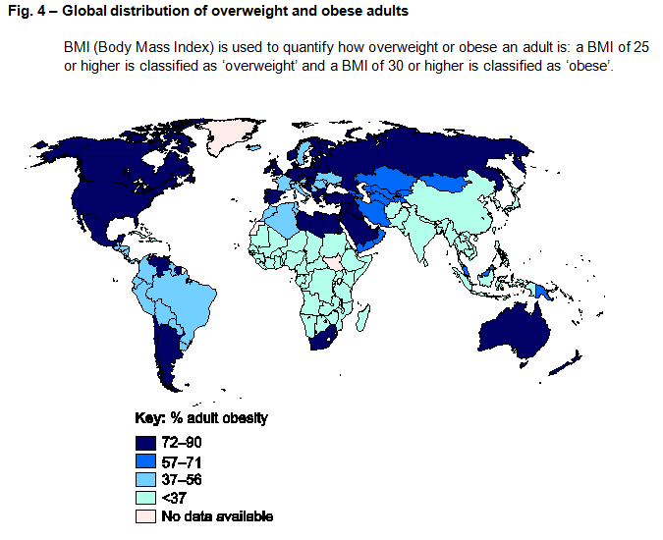
Topic 3.4 – Question 4(a) – 3 marks
Identify three limitations with the data evidence in Fig. 4.
This is a 3 mark question where all marks are allocated to AO3 (skills).
‘Undertake informed and critical questioning of data sources, analytical methodologies, data reporting and presentation’ is stated in the specification (section 4.1 of the geographical skills list in the specification) and this question is directly targeting this skill.
Fig. 4 shows a map of the global distribution of overweight and obese adults.

Slide 33
Topic 3.4 – Question 4(a) – 3 marks
Identify three limitations with the data evidence in Fig. 4.
There are 3 marks available – all for limitations of the data evidence identified through critical questioning of the resource (✓).
Examples of points suggested in the mark scheme include:
There is a considerable difference in the BMI of adults who are overweight compared to those who are obese, if mapped separately then the patterns may be quite different (✓).
The categories on the key are not evenly distributed, for example between 72-90% there is a difference of 18% whereas 57-71% the difference is 14% (✓).
There is no time period defined on this map either for when the data was gathered or displayed on the actual map (✓).

Slide 34
Topic 3.4 – Question 4(b) – 6 marks
Explain the physical conditions necessary for growing food.
This is a 6 mark question where all marks are allocated to AO1 (knowledge and understanding).
‘The physical conditions required for growing food including, air, climate, soil and water’ is stated in the specification (key idea 1.b of this topic).
As this is a level marked question, the answer is not point marked. Therefore the mark a student achieves depends on where they sit in the level mark scheme. Remember there is level of response questions marking guidance to indicate what ‘thorough’, ‘reasonable’ and ‘basic’ mean at the start of the mark schemes (and slide 10 of this presentation).
Level 3 (5–6 marks)
Demonstrates thorough knowledge and understanding of the physical conditions necessary for growing food (AO1).
This will be shown by including well-developed ideas about the physical conditions necessary for growing food.
Level 2 (3–4 marks)
Demonstrates reasonable knowledge and understanding of the physical conditions necessary for growing food (AO1).
This will be shown by including developed ideas about the physical conditions necessary for growing food.
Level 1 (1–2 marks)
Demonstrates basic knowledge and understanding of the physical conditions necessary for growing food (AO1).
This will be shown by including simple ideas about the physical conditions necessary for growing food.

Slide 35
Topic 3.4 – Question 4(b) – 6 marks
Explain the physical conditions necessary for growing food.
The ‘Indicative content’ column of the mark scheme gives a number of suggestions of knowledge and understanding which could be incorporated into answers for this question. The list is not exhaustive and students should be rewarded for any appropriate knowledge and understanding shown.
Knowledge and understanding of the physical conditions necessary for growing food could potentially include:
air – plants need carbon dioxide for growth. Part of the process of photosynthesis for plants to generate food
climate (temperature and rainfall) – temperate crops (cereals) grow between 15 and 20 degrees where-as tropical crops (rice) grow between 16 and 27 degrees. Outside of these temperatures (particularly frost conditions) could result in lower crop yields. Rainfall patterns in places such as Southern Africa and Southern Asia cause bursts of crop growth and planting is linked to seasonal variations whereas rainforest areas such as the Amazon crop growth is optimised in the drier season (June – Sept) as there is sufficient groundwater flow
soils have mineral and organic matter to support plant growth. They provide critical nutrients for plant growth, water and a structure for root systems to develop. Examples of essential nutrients for plant growth are: carbon, nitrogen, phosphorus, calcium and potassium; these are absorbed through plant root systems
water has dissolved nutrients which plants can absorb through root systems (root hairs). Plants require variations in water access depending on the stages of their development. Frequency and depth of irrigation affects yields. For example Maize yields are affected if there is a water deficit during the flowering period
water uptake by plants needs to be offset against transpiration levels to ensure that growing conditions are optimised. Plant root depth will impact on absorption rates for water. Alternatively waterlogged soils do not allow seeds to germinate
the permeability and porosity of soils can help or hinder water movement. If water is easily lost through soils then nutrients are leached affecting plant growth
other factors could be explained such as: elevation (impact on temperature, soil depth and acidity), light (day light hours), salinity (especially with high rates of evaporation), wind and humidity.

Slide 36
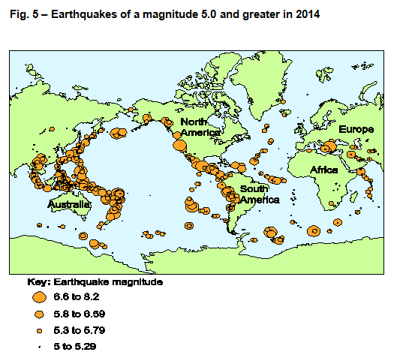
Topic 3.5 – Question 5(a) – 3 marks
Identify three limitations with the data evidence in Fig. 5.
This is a 3 mark question where all marks are allocated to AO3 (skills).
‘Undertake informed and critical questioning of data sources, analytical methodologies, data reporting and presentation’ is stated in the specification (section 4.1 of the geographical skills list in the specification) and this question is directly targeting this skill.
Fig. 5 shows a map of earthquakes of a magnitude 5.0 and greater in 2014.

Slide 37
Topic 3.5 – Question 5(a) – 3 marks
Identify three limitations with the data evidence in Fig. 5.
There are 3 marks available – all for limitations of the data evidence identified through critical questioning of the resource (✓).
Examples of points suggested in the mark scheme include:
Map projection doesn’t show the whole world map so earthquakes may have happened which were then not mapped (✓).
The clustering of earthquake activity in particular areas of the map such as north and east of Australia make it difficult to identify the range of earthquake magnitudes (✓).
The magnitude categories on the key; become narrower as the magnitude decreases. The difference between 6.6 and 8.2 is 1.6, at the bottom of the scale the difference between 5 and 5.29 is 0.29 (✓).

Slide 38
Topic 3.5 – Question 5(b) – 6 marks
Explain the features and processes at divergent plate boundaries.
This is a 6 mark question where all marks are allocated to AO1 (knowledge and understanding).
‘Earth’s crustal features and processes, including…the features and processes associated with divergent (constructive)
plate boundaries’ is stated in the specification (key idea 1.b of this topic).
As this is a level marked question, the answer is not point marked. Therefore the mark a student achieves depends on where they sit in the level mark scheme. Remember there is level of response questions marking guidance to indicate what ‘thorough’, ‘reasonable’ and ‘basic’ mean at the start of the mark schemes (and slide 10 of this presentation).
Level 3 (5–6 marks)
Demonstrates thorough knowledge and understanding of the features and processes at divergent plate boundaries (AO1).
This will be shown by including well-developed ideas about the features and processes at divergent plate boundaries.
Level 2 (3–4 marks)
Demonstrates reasonable knowledge and understanding of the features and processes at divergent plate boundaries (AO1).
This will be shown by including developed ideas about the features and processes at divergent plate boundaries.
Level 1 (1–2 marks)
Demonstrates basic knowledge and understanding of the features and processes at divergent plate boundaries (AO1).
This will be shown by including simple ideas about the features and processes at divergent plate boundaries.

Slide 39
Topic 3.5 – Question 5(b) – 6 marks
Explain the features and processes at divergent plate boundaries.
The ‘Indicative content’ column of the mark scheme gives a number of suggestions of knowledge and understanding which could be incorporated into answers for this question. The list is not exhaustive and students should be rewarded for any appropriate knowledge and understanding shown.
Knowledge and understanding of the features and processes at divergent plate boundaries could potentially include:
divergent boundaries mark the divergence of two lithospheric plates. These plates move apart by convection currents which form in the asthenosphere below. These convection currents are believed to be driven by heat created by radioactive decay in the earth’s core
when two oceanic plates move apart by convection currents; melting of the upper mantle produces basaltic magma. Magma rises up to the sea bed forming a mid-ocean ridge, this process is known as sea floor spreading
in some areas along the Mid-Atlantic ridge (spreading at a rate of 2-3cm per year), notably Iceland, the ridge reaches above sea level. As magma rises at the ridge new lithosphere is created on the edges of the diverging plates and the new crust spreads laterally away from the ridge (sea floor spreading)
along the crest of the ridge there may be rift valleys found (as along the mid-Atlantic) due to tensional forces created as the two plates move apart, ridges have an irregular pattern and are offset by transform faults, large cracks at right angles to the plate boundaries
as well as volcanic activity, constructive activities are characterised by shallow focus earthquakes associated with the rising magma and the tensional stress between plates sliding past each other along transform faults
eruption of magma underwater creates pillow lava formed by rapid cooling of lava creating rounded mounds
where divergence occurs beneath a continental plate it can lead to the development of a rift valley. As the divergence occurs, fracturing of the plates creates a rift and as extensional forces continue, faults form on either side of the rift. The central block then gradually slides down creating a rift valley such as the East Africa Rift Valley.

Slide 40
Section B
This section will always contain one synoptic question for each of the five options. Students must answer questions from two topics.
The questions will always be 12 mark questions which are split evenly between AO1 and AO2 – analyse.
Synoptic questions involve the explicit drawing together of knowledge, skills and understanding within different parts of the A Level course. The questions will draw together the topic from Geographical debates (02) with an area of content within Landscape and place (01) – with the initial focus of the question always being on the geographical debate.
Every option in Section B will always have an identical structure so that they are comparable.
This structure will be the same structure which will be used in future examinations.

Slide 41
Topic 3.1 – Question 6 – 12 marks
Examine how climate change may be impacting the carbon cycle in the Arctic tundra.
This is a 12 mark question which has marks allocated to both knowledge and understanding (AO1 – 6 marks) and application of knowledge and understanding (AO2 – 6 marks).
This question requires knowledge and understanding (AO1) of both climate change (topic 3.1) and the carbon cycle in the Arctic tundra (topic 1.2).
This question also requires students to apply their knowledge and understanding (AO2) of the content learned to examine how climate change may be impacting the carbon cycle in the Arctic tundra.
This question requires the application of knowledge and understanding (AO2) in order to make links between such types of material which are not signalled in the specification – one of the three ways we must assess application of knowledge and understanding.
As this is a level marked question, the answer is not point marked. Therefore the mark a student achieves depends on where they sit in the level mark scheme. Remember there is level of response questions marking guidance to indicate what ‘thorough’, ‘reasonable’ and ‘basic’ mean at the start of the mark schemes (and slide 10 of this presentation).

Slide 42
Topic 3.1 – Question 6 – 12 marks
Examine how climate change may be impacting the carbon cycle in the Arctic tundra.
Level 4 (10–12 marks)
Demonstrates comprehensive knowledge and understanding of climate change and the carbon cycle in the Arctic tundra (AO1).
Demonstrates comprehensive application of knowledge and understanding to provide clear, developed and convincing analysis that is fully accurate of how climate change may be impacting the carbon cycle in the Arctic tundra (AO2).
This will be shown by including well-developed ideas about climate change and the carbon cycle in the Arctic tundra.
There are clear and explicit attempts to make appropriate synoptic links between content from different parts of the course of study.
Level 3 (7–9 marks)
Demonstrates thorough knowledge and understanding of climate change and the carbon cycle in the Arctic tundra (AO1).
Demonstrates thorough application of knowledge and understanding to provide clear and developed analysis that shows accuracy of how climate change may be impacting the carbon cycle in the Arctic tundra (AO2).
This will be shown by including well-developed ideas about either climate change or the carbon cycle in the Arctic tundra and developed ideas for the other focus.
There are clear attempts to make synoptic links between content from different parts of the course of study but these are not always appropriate.
Level 2 (4–6 marks)
Demonstrates reasonable knowledge and understanding of climate change and the carbon cycle in the Arctic tundra (AO1).
Demonstrates reasonable application of knowledge and understanding to provide sound analysis that shows some accuracy of how climate change may be impacting the carbon cycle in the Arctic tundra (AO2).
This will be shown by including developed ideas about either climate change or the carbon cycle in the Arctic tundra and simple ideas for the other focus.
There are some attempts to make synoptic links between content from different parts of the course of study but these are not always relevant.
Level 1 (1–3 marks)
Demonstrates basic knowledge and understanding of climate change and the carbon cycle in the Arctic tundra (AO1).
Demonstrates basic application of knowledge and understanding to provide simple analysis that shows limited accuracy of how climate change may be impacting the carbon cycle in the Arctic tundra (AO2).
This will be shown by including simple ideas about climate change and the carbon cycle in the Arctic tundra.
There are limited attempts to make synoptic links between content from different parts of the course of study.

Slide 43
Topic 3.1 – Question 6 – 12 marks
The ‘Indicative content’ column of the mark scheme gives a number of suggestions of ‘knowledge and understanding’ and ‘application of knowledge and understanding’ which could be incorporated into answers for this question. The list is not exhaustive and students should be rewarded for any appropriate ‘knowledge and understanding’ or ‘application of knowledge and understanding’ shown.
AO1 – 6 marks
Knowledge and understanding of climate change and the carbon cycle in the Arctic tundra could potentially include:
increase in surface and atmospheric temperatures
increasing atmospheric water vapour
climate modelling to show the importance of the carbon cycle
carbon cycles have inputs, outputs and stores, refer to Arctic tundra
physical factors affecting rates of flow and stores e.g. temperature, vegetation, organic matter in soil and mineral composition of rocks
short term and long term changes in the carbon cycle (including seasonality)
dynamic equilibrium in the cycle (balance between stores and flows).
AO2 – 6 marks
Application of knowledge and understanding to analyse how climate change may be impacting the carbon cycle in the Arctic tundra could potentially include:
permafrost is a vast carbon sink, rising Arctic temperatures (above 0 degrees for part of the year) causes a decline in permafrost (decomposition). Processes that move permafrost carbon from frozen to thawed releases the stored carbon, increasing the carbon pool. This carbon can then be released into the atmosphere
in the Arctic the rate of decomposition is usually slow and limited mainly to the summer months, a warming climate encourages faster decomposition and the release of nutrients for plant growth
rising temperatures increases the length of the growing season. There is increased photosynthesis so more atmospheric carbon dioxide is absorbed
forest fires due to periods of drought can release a significant amount of carbon into the atmosphere. The forest fire destroys plants which can absorb carbon from the atmosphere
ecosystems in the Arctic tundra are changing and potentially adapting to climate changes such as plant growing seasons, growth rates and species composition however this cannot compensate for the thawing permafrost.

Slide 44
Topic 3.2 – Question 7 – 12 marks
‘It is more challenging to mitigate against communicable diseases in areas with human rights or territorial integrity conflicts’
For either human rights conflicts or territorial integrity conflicts, how far do you agree with the statement?
This is a 12 mark question which has marks allocated to both knowledge and understanding (AO1 – 6 marks) and application of knowledge and understanding (AO2 – 6 marks).
This question requires knowledge and understanding (AO1) of both communicable disease mitigation (topic 3.2) and areas of either human rights or territorial integrity conflicts (either topic 2.2.3 or 2.2.4).
This question also requires students to apply their knowledge and understanding (AO2) of the content learned to determine how far they agree with the statement.
This question requires the application of knowledge and understanding (AO2) in order to make links between such types of material which are not signalled in the specification – one of the three ways we must assess application of knowledge and understanding.
As this is a level marked question, the answer is not point marked. Therefore the mark a student achieves depends on where they sit in the level mark scheme. Remember there is level of response questions marking guidance to indicate what ‘thorough’, ‘reasonable’ and ‘basic’ mean at the start of the mark schemes (and slide 10 of this presentation).

Slide 45
Topic 3.2 – Question 7 – 12 marks
‘It is more challenging to mitigate against communicable diseases in areas with human rights or territorial integrity conflicts’
For either human rights conflicts or territorial integrity conflicts, how far do you agree with the statement?
Level 4 (10–12 marks)
Demonstrates comprehensive knowledge and understanding of communicable disease mitigation and areas of either human rights or territorial integrity conflicts (AO1).
Demonstrates comprehensive application of knowledge and understanding to provide clear, developed and convincing analysis that is fully accurate of the challenges to mitigating against communicable diseases in areas of human rights or territorial integrity conflicts (AO2).
This will be shown by including well-developed ideas about communicable disease mitigation and areas of either human rights or territorial integrity conflicts.
There are clear and explicit attempts to make appropriate synoptic links between content from different parts of the course of study.
Level 3 (7–9 marks)
Demonstrates thorough knowledge and understanding of communicable disease mitigation and areas of either human rights or territorial integrity conflicts (AO1).
Demonstrates thorough application of knowledge and understanding to provide clear and developed analysis that shows accuracy of the challenges to mitigating against communicable diseases in areas of human rights or territorial integrity conflicts (AO2).
This will be shown by including well-developed ideas about either communicable disease mitigation or areas of either human rights or territorial integrity and developed ideas for the other focus.
There are clear attempts to make synoptic links between content from different parts of the course of study but these are not always appropriate.
Level 2 (4–6 marks)
Demonstrates reasonable knowledge and understanding of communicable disease mitigation and areas of either human rights or territorial integrity conflicts (AO1).
Demonstrates reasonable application of knowledge and understanding to provide sound analysis that shows some accuracy of the challenges to mitigating against communicable diseases in areas of human rights or territorial integrity conflicts (AO2).
This will be shown by including developed ideas about either communicable disease mitigation or areas of either human rights or territorial integrity and simple ideas for the other focus.
There are some attempts to make synoptic links between content from different parts of the course of study but these are not always relevant.
Level 1 (1–3 marks)
Demonstrates basic knowledge and understanding of communicable disease mitigation and areas of either human rights or territorial integrity conflicts (AO1).
Demonstrates basic application of knowledge and understanding to provide simple analysis that shows limited accuracy of the challenges to mitigating against communicable diseases in areas of human rights or territorial integrity conflicts (AO2).
This will be shown by including simple ideas about communicable disease mitigation and areas of either human rights or territorial integrity conflicts.
There are limited attempts to make synoptic links between content from different parts of the course of study.

Slide 46
Topic 3.2 – Question 7 – 12 marks
The ‘Indicative content’ column of the mark scheme gives a number of suggestions of ‘knowledge and understanding’ and ‘application of knowledge and understanding’ which could be incorporated into answers for this question. The list is not exhaustive and students should be rewarded for any appropriate ‘knowledge and understanding’ or ‘application of knowledge and understanding’ shown.
AO1 – 6 marks
Knowledge and understanding of mitigation against communicable diseases and human rights conflicts or territorial integrity conflicts could potentially include:
direct strategies used by governments and international agencies
indirect strategies used by governments and international agencies
response to outbreaks at national and international scales
prediction of diseases by international organisations such as the World Health Organization
role of an NGO in dealing with a disease outbreak at national and local level
global and national campaigns for disease eradication
Human rights conflicts
spatial patterns of human rights such as forced labour or maternal mortality rates
patterns of gender inequalities such as access to reproductive health services
violation of human rights can be a consequence of conflict such as inhospitable living conditions or lack of access to medical care
OR - Territorial integrity conflicts:
loss of territorial integrity through political boundaries, transnational corporations or dominance of ethnic groups
challenges to territorial integrity can cause conflicts such as access to natural resources
strategies for global governance in one area of conflict
AO2 – 6 marks
Application of knowledge and understanding to analyse the challenges to mitigate against communicable diseases in areas with human rights or territorial integrity conflicts could potentially include:
population movements due to conflict making vaccination and treatment programs difficult to coordinate
population density variations (refugee camps or informal settlements in LIDCs) and the impact this has on the rate of disease spread
role of international organisations such as the UN or NGOs e.g. Médecins Sans Frontières / Doctors Without Borders in coordinating relief and medical supplies in conflicts. The scale of a disease outbreak not always treatable with limited supplies
physical and geographical barriers such as mountains, lack of water, deserts leave some communities and groups (such as women) isolated and lack of accessibility impacts access to medical treatments
many communicable diseases are preventable through national and international strategies but lack of access to food and clean water or poor living conditions and poor sanitation creates a greater risk.

Slide 47
Topic 3.3 – Question 8 – 12 marks
Assess how the use of oceans is affected by either the global system of trade or the global system of migration.
This is a 12 mark question which has marks allocated to both knowledge and understanding (AO1 – 6 marks) and application of knowledge and understanding (AO2 – 6 marks).
This question requires knowledge and understanding (AO1) of both the use of oceans (topic 3.3) and the global trade system or the global system of migration (either topic 2.2.1 or 2.2.2).
This question also requires students to apply their knowledge and understanding (AO2) of the content learned assess how the use of oceans is affected by either the global system of trade or the global system of migration.
This question requires the application of knowledge and understanding (AO2) in order to make links between such types of material which are not signalled in the specification – one of the three ways we must assess application of knowledge and understanding.
As this is a level marked question, the answer is not point marked. Therefore the mark a student achieves depends on where they sit in the level mark scheme. Remember there is level of response questions marking guidance to indicate what ‘thorough’, ‘reasonable’ and ‘basic’ mean at the start of the mark schemes (and slide 10 of this presentation).

Slide 48
Topic 3.3 – Question 8 – 12 marks
Assess how the use of oceans is affected by either the global system of trade or the global system of migration.
Level 4 (10–12 marks)
Demonstrates comprehensive knowledge and understanding of the use of oceans and either the global trade system or the global system of migration (AO1).
Demonstrates comprehensive application of knowledge and understanding to provide clear, developed and convincing analysis that is fully accurate of how the use of oceans is affected by either the global system of trade or the global system of migration (AO2).
This will be shown by including well-developed ideas about the use of oceans and either the global trade system or the global system of migration.
There are clear and explicit attempts to make appropriate synoptic links between content from different parts of the course of study.
Level 3 (7–9 marks)
Demonstrates thorough knowledge and understanding of the use of oceans and either the global trade system or the global system of migration (AO1).
Demonstrates thorough application of knowledge and understanding to provide clear and developed analysis that shows accuracy of how the use of oceans is affected by either the global system of trade or the global system of migration (AO2).
This will be shown by including well-developed ideas about either the use of oceans or either the global trade system or the global system of migration and developed ideas for the other focus.
There are clear attempts to make synoptic links between content from different parts of the course of study but these are not always appropriate.
Level 2 (4–6 marks)
Demonstrates reasonable knowledge and understanding of the use of oceans and either the global trade system or the global system of migration (AO1).
Demonstrates reasonable application of knowledge and understanding to provide sound analysis that shows some accuracy of how the use of oceans is affected by either the global system of trade or the global system of migration (AO2).
This will be shown by including developed ideas about either the use of oceans or either the global trade system or the global system of migration and simple ideas for the other focus.
There are some attempts to make synoptic links between content from different parts of the course of study but these are not always relevant.
Level 1 (1–3 marks)
Demonstrates basic knowledge and understanding of the use of oceans and either the global trade system or the global system of migration (AO1).
Demonstrates basic application of knowledge and understanding to provide simple analysis that shows limited accuracy of how the use of oceans is affected by either the global system of trade or the global system of migration (AO2).
This will be shown by including simple ideas about the use of oceans and either the global trade system or the global system of migration.
There are limited attempts to make synoptic links between content from different parts of the course of study.

Slide 49
Topic 3.3 – Question 8 – 12 marks
The ‘Indicative content’ column of the mark scheme gives a number of suggestions of ‘knowledge and understanding’ and ‘application of knowledge and understanding’ which could be incorporated into answers for this question. The list is not exhaustive and students should be rewarded for any appropriate ‘knowledge and understanding’ or ‘application of knowledge and understanding’ shown.
AO1 – 6 marks
Knowledge and understanding of the use of oceans and the global system of trade or global system of migration could potentially include:
the use of biological, energy or mineral resources
the use of ocean systems as waste disposal sites, via pollution
the use of oceans by countries to exert their influence such as ports and marine conflict zones
the use of oceans as escape routes for migrants.
Global system of trade:
spatial patterns of international trade
can promote stability or create inequalities through flows of people, money, ideas and technology
transport and communications have increased connectivity to global supply chains
increased connectivity through increased labour mobility.
OR - Global system of migration:
spatial patterns of global migration
can promote stability or create inequalities through flows of people, money, ideas and technology
economic globalisation leading to emergence of new source areas and host destinations
conflict and persecution have led to increased numbers of refugees.
AO2 – 6 marks
Application of knowledge and understanding to analyse how the use of oceans is affected by either the global system of trade or the global system of migration could potentially include:
varying demand for biological and mineral resources as raw materials to trade. The complexity of access to these resources particularly minerals will determine who has the right to trade them. The location of the resources and their distance travelled impacts on the financial costs of trade
oceans are increasingly being used as a means of transport for goods through increasing international trade. The world is becoming increasingly connected and shipping continues to evolve and become more mechanised such as containerisation. This leads to increasing port size and the growth of shipping routes
increased connectivity globally through economic globalisation means labour migrations have increased and there are new and emerging host and source areas via the oceans. However oceans have seen an increase in the number of illegal migrants and refugees through organised and systematic routes. Globally, there is increased awareness of this through media coverage
pollutants (domestic and industrial) affecting ocean systems can create inequalities in flows as major polluters don’t always bare the environmental (impact on ecosystems) or economic costs. There can be implications on flows of money and / or technology to deal with the effects of pollutants
territorial waters such as the South China Sea can be sources of conflict as they are shipping routes and have great value to a number of countries. The South China Sea has two chains of islands with mineral resources and the area has high fish stocks. Disputes between China, Vietnam and the Philippines in particular relate to the geographical position of the islands, sovereignty rights, trade routes and access to resources.

Slide 50
Topic 3.4 – Question 9 – 12 marks
Assess how globalisation of the food industry affects stores in water systems.
This is a 12 mark question which has marks allocated to both knowledge and understanding (AO1 – 6 marks) and application of knowledge and understanding (AO2 – 6 marks).
This question requires knowledge and understanding (AO1) of both globalisation of the food industry (topic 3.4) and the stores in water systems (topic 1.2).
This question also requires students to apply their knowledge and understanding (AO2) of the content learned to assess how globalisation of the food industry affects stores in water systems.
This question requires the application of knowledge and understanding (AO2) in order to make links between such types of material which are not signalled in the specification – one of the three ways we must assess application of knowledge and understanding.
As this is a level marked question, the answer is not point marked. Therefore the mark a student achieves depends on where they sit in the level mark scheme. Remember there is level of response questions marking guidance to indicate what ‘thorough’, ‘reasonable’ and ‘basic’ mean at the start of the mark schemes (and slide 10 of this presentation).

Slide 51
Topic 3.4 – Question 9 – 12 marks
Assess how globalisation of the food industry affects stores in water systems.
Level 4 (10–12 marks)
Demonstrates comprehensive knowledge and understanding of the globalisation of the food industry and the stores in water systems (AO1).
Demonstrates comprehensive application of knowledge and understanding to provide clear, developed and convincing analysis that is fully accurate of how globalisation of the food industry affects stores in water systems (AO2).
This will be shown by including well-developed ideas about globalisation of the food industry and the stores in water systems.
There are clear and explicit attempts to make appropriate synoptic links between content from different parts of the course of study.
Level 3 (7–9 marks)
Demonstrates thorough knowledge and understanding of the globalisation of the food industry and the stores in water systems (AO1).
Demonstrates thorough application of knowledge and understanding to provide clear and developed analysis that shows accuracy of how globalisation of the food industry affects stores in water systems (AO2).
This will be shown by including well-developed ideas about either globalisation of the food industry or the stores in water systems and developed ideas for the other focus.
There are clear attempts to make synoptic links between content from different parts of the course of study but these are not always appropriate.
Level 2 (4–6 marks)
Demonstrates reasonable knowledge and understanding of the globalisation of the food industry and the stores in water systems (AO1).
Demonstrates reasonable application of knowledge and understanding to provide sound analysis that shows some accuracy of how globalisation of the food industry affects stores in water systems (AO2).
This will be shown by including developed ideas about either globalisation of the food industry or the stores in water systems and simple ideas for the other focus.
There are some attempts to make synoptic links between content from different parts of the course of study but these are not always relevant.
Level 1 (1–3 marks)
Demonstrates basic knowledge and understanding of the globalisation of the food industry and the stores in water systems (AO1).
Demonstrates basic application of knowledge and understanding to provide simple analysis that shows limited accuracy of how globalisation of the food industry affects stores in water systems (AO2).
This will be shown by including simple ideas about globalisation of the food industry and the stores in water systems.
There are limited attempts to make synoptic links between content from different parts of the course of study.

Slide 52
Topic 3.4 – Question 9 – 12 marks
The ‘Indicative content’ column of the mark scheme gives a number of suggestions of ‘knowledge and understanding’ and ‘application of knowledge and understanding’ which could be incorporated into answers for this question. The list is not exhaustive and students should be rewarded for any appropriate ‘knowledge and understanding’ or ‘application of knowledge and understanding’ shown.
AO1 – 6 marks
Knowledge and understanding of globalisation of the food industry and stores in water systems could potentially include:
globalisation of the food industry such as increased demand and global tastes such as fast foods
trans-national corporations and the scale of their operations to produce food for the global food market such as Unilever
globalisation of food could lead to opportunities for technological innovations such as GM crops, irrigation, hydroponics
stores in water systems such as groundwater supplies, water bodies (lakes and reservoirs), soil, vegetation and the atmosphere
stores of water vary in distribution and size and can change over time
stores of water can be influenced by a variety of inputs (precipitation) and outputs (evapotranspiration)
how water extraction such as groundwater extraction impacts the stores in the water cycle.
AO2 – 6 marks
Application of knowledge and understanding to analyse how globalisation of the food industry affects stores in water systems could potentially include:
irrigation affects the quantity of groundwater stores, altering the hydrological conditions from installation. Aquifers experience seasonal fluctuations in groundwater levels throughout the year. Irrigation can increase rates of evaporation however groundwater can also be recharged via infiltration and deep percolation
population growth can increase the demand for food supplies overall especially with crops such as rice. Rice needs significant water in which to grow which can lead to greater land areas saturated and higher rates of evapotranspiration
groundwater mining with wells for agricultural use can cause water levels to fall and this can be unsustainable
westernisation of diets due to globalisation at a mass market scale impacts on food production e.g. animal feed for meat production leads to a greater demand on water supplies
GM crops produced due to increased consumer demand are rapid growing and need more water and nutrients; this can drain water tables and soil water stores
technological innovations such as hydroponics could lead to strains on groundwater supplies or particular rainwater gathering techniques could lead to groundwater supplies being maintained
if one country exports a water-intensive product to another country, it can support the other country in their water needs (virtual water). Depending on levels of trade will vary the impact on water systems but it is likely to be low
the intensity of crop growth such as cereals due to consumer demand can improve the drainage of soils as root networks access soil water stores however irrigation techniques can encourage water logging where drainage is poor and the water table rises.

Slide 53
Topic 3.5 – Question 10 – 12 marks
Examine how the risks from tectonic hazards affect place making processes.
This is a 12 mark question which has marks allocated to both knowledge and understanding (AO1 – 6 marks) and application of knowledge and understanding (AO2 – 6 marks).
This question requires knowledge and understanding (AO1) of both risks from tectonic hazards (topic 3.5) and place making processes (topic 2.1).
This question also requires students to apply their knowledge and understanding (AO2) of the content learned to examine how the risks from tectonic hazards affect place making processes.
This question requires the application of knowledge and understanding (AO2) in order to make links between such types of material which are not signalled in the specification – one of the three ways we must assess application of knowledge and understanding.
As this is a level marked question, the answer is not point marked. Therefore the mark a student achieves depends on where they sit in the level mark scheme. Remember there is level of response questions marking guidance to indicate what ‘thorough’, ‘reasonable’ and ‘basic’ mean at the start of the mark schemes (and slide 10 of this presentation).

Slide 54
Topic 3.5 – Question 10 – 12 marks
Examine how the risks from tectonic hazards affect place making processes.
Level 4 (10–12 marks)
Demonstrates comprehensive knowledge and understanding of risks from tectonic hazards and place making processes (AO1).
Demonstrates comprehensive application of knowledge and understanding to provide clear, developed and convincing analysis that is fully accurate of how the risks from tectonic hazards affect place making processes (AO2).
This will be shown by including well-developed ideas about risks from tectonic hazards and place making processes.
There are clear and explicit attempts to make appropriate synoptic links between content from different parts of the course of study.
Level 3 (7–9 marks)
Demonstrates thorough knowledge and understanding of risks from tectonic hazards and place making processes (AO1).
Demonstrates thorough application of knowledge and understanding to provide clear and developed analysis that shows accuracy of how the risks from tectonic hazards affect place making processes (AO2).
This will be shown by including well-developed ideas about either risks from tectonic hazards or place making processes and developed ideas for the other focus.
There are clear attempts to make synoptic links between content from different parts of the course of study but these are not always appropriate.
Level 2 (4–6 marks)
Demonstrates reasonable knowledge and understanding of risks from tectonic hazards and place making processes (AO1).
Demonstrates reasonable application of knowledge and understanding to provide sound analysis that shows some accuracy of how the risks from tectonic hazards affect place making processes (AO2).
This will be shown by including developed ideas about either risks from tectonic hazards or place making processes and simple ideas for the other focus.
There are some attempts to make synoptic links between content from different parts of the course of study but these are not always relevant.
Level 1 (1–3 marks)
Demonstrates basic knowledge and understanding of risks from tectonic hazards and place making processes (AO1).
Demonstrates basic application of knowledge and understanding to provide simple analysis that shows limited accuracy of how the risks from tectonic hazards affect place making processes (AO2).
This will be shown by including simple ideas about risks from tectonic hazards and place making processes.
There are limited attempts to make synoptic links between content from different parts of the course of study.

Slide 55
Topic 3.5 – Question 10 – 12 marks
The ‘Indicative content’ column of the mark scheme gives a number of suggestions of ‘knowledge and understanding’ and ‘application of knowledge and understanding’ which could be incorporated into answers for this question. The list is not exhaustive and students should be rewarded for any appropriate ‘knowledge and understanding’ or ‘application of knowledge and understanding’ shown.
AO1 – 6 marks
Knowledge and understanding of the risks from tectonic hazards and place making processes could potentially include:
changes in the frequency and impacts of tectonic hazards over time
degree of risk posed by a hazard and the probability of the hazard event occurring
reasons why people choose to live in tectonically active locations
future strategies to cope with risks from tectonic hazards
how governments and organisations attempt to present places to the wider world to attract inward investment and regeneration
why places rebrand through reimaging and regeneration to construct a different place meaning
range of strategies can be used to rebrand places such as art, heritage and architecture. These can be used to change a place meaning
range of players and their role in placemaking such as governments, not for profit or community groups.
AO2 – 6 marks
Application of knowledge and understanding to analyse how the risks from tectonic hazards affect place making processes could potentially include:
places prone to tectonic hazards such as California have a variety of strategies to mitigate against the risks, which creates a particular place meaning and enables communities to live with the risks
regeneration following a tectonic event such as the Christchurch earthquake can be more about rebuilding what was there to preserve the place meaning
where places are considered or perceived to be ‘riskier’ due to the frequency of tectonic hazards it can be challenging for players to encourage inward investment for regeneration
there can be a time lapse between tectonic hazards occurring and the regeneration of places such as the Montserrat eruption. The government are working with a number of not for profit organisations as they are looking to re-establish communities in the south of the Island. The complexities of the place making processes have included where it is safe for communities to establish themselves, what the physical buildings will look like and be organised, how the communities will reimagine themselves to create a different place meaning
role of players in tectonically hazardous areas and in place making processes are key to mitigating against the risks, encouraging investment, rebranding and reimaging. These players act as gatekeepers influencing the degree to which the risks are dealt with in place making processes.

Slide 56
Section C
There will be a choice of two questions for each topic in section C – students answer one question from both of their two different topics but the choice gives them flexibility within the exam.
The questions will always be 33 mark questions which are split between AO1 and AO2.
Students should draw on their knowledge and understanding from the topic to answer their chosen question which includes case studies references or information.
Every option in Section C will always have an identical structure so that they are comparable.
This structure will be the same structure which will be used in future examinations.

Slide 57
Topic 3.1 – Question 11* – 33 marks
‘The vulnerability of people to the impacts of climate change is mainly the result of economic factors.’ Discuss.
The questions for all topics in Section C of the Geographical debates (03) question paper will always be a 33 mark question which will have 9 marks allocated to AO1 (knowledge and understanding) and 24 marks allocated to AO2 (application of knowledge and understanding).
This question requires knowledge and understanding (AO1 – 9 marks) of the vulnerability of people to the impacts of climate change (information from key ideas 2.a, 4.b and 4.c of this topic in the specification could be useful).
This question also requires the application of knowledge and understanding (AO2 – 24 marks) in order to develop further the material covered in the specification – another way we must assess application of knowledge and understanding. The command to ‘discuss’ indicates that students must apply their knowledge and understanding by analysing and evaluating. Students must weigh up information to determine whether the vulnerability of people to the impacts of climate change is mainly the result of economic factors.
There is no ‘correct’ way in which students should answer this question and the response will depend on which areas of the topic they draw together to answer this question.

Slide 58
Topic 3.1 – Question 11* – 33 marks – The mark scheme – AO1 (9 marks)
AO1
Level 4 (7–9 marks)
Demonstrates comprehensive knowledge and understanding of the vulnerability of people to the impacts of climate change.
Level 3 (5–6 marks)
Demonstrates thorough knowledge and understanding of the vulnerability of people to the impacts of climate change.
Level 2 (3–4 marks)
Demonstrates reasonable knowledge and understanding of the vulnerability of people to the impacts of climate change.
Level 1 (1–2 marks)
Demonstrates basic knowledge and understanding of the vulnerability of people to the impacts of climate change.
0 marks
No response or no response worthy of credit.
Remember there is level of response questions marking guidance to indicate what ‘comprehensive’, ‘thorough’, ‘reasonable’ and ‘basic’ mean at the start of the mark schemes (and slide 10 of this presentation).

Slide 59
Topic 3.1 – Question 11* – 33 marks – The mark scheme – AO2 (24 marks)
AO2
Level 4 (19–24 marks)
Demonstrates comprehensive application of knowledge and understanding to provide a clear, developed and convincing analysis that is fully accurate of factors which affect the vulnerability of people to the impacts of climate change.
Demonstrates comprehensive application of knowledge and understanding to provide a detailed and substantiated evaluation that offers secure judgements leading to rational conclusions that are evidence based as to whether the vulnerability of people to the impacts of climate change is mainly the result of economic factors.
Relevant concepts are authoritatively discussed.
Level 3 (13–18 marks)
Demonstrates thorough application of knowledge and understanding to provide a clear and developed analysis that shows accuracy of factors which affect the vulnerability of people to the impacts of climate change.
Demonstrates thorough application of knowledge and understanding to provide a detailed evaluation that offers generally secure judgements, with some link between rational conclusions and evidence as to whether the vulnerability of people to the impacts of climate change is mainly the result of economic factors.
Relevant concepts are discussed but this may lack some authority.
Level 2 (7–12 marks)
Demonstrates reasonable application of knowledge and understanding to provide a sound analysis that shows some accuracy of factors which affect the vulnerability of people to the impacts of climate change.
Demonstrates reasonable application of knowledge and understanding to provide a sound evaluation that offers generalised judgements and conclusions, with limited use of evidence as to whether the vulnerability of people to the impacts of climate change is mainly the result of economic factors.
Concepts are discussed but their use lacks precision.
Level 1 (1–6 marks)
Demonstrates basic application of knowledge and understanding to provide a simple analysis that shows limited accuracy of factors which affect the vulnerability of people to the impacts of climate change.
Demonstrates basic application of knowledge and understanding to provide an un-supported evaluation that offers simple conclusions as to whether the vulnerability of people to the impacts of climate change is mainly the result of economic factors.
Concepts are not discussed or are so inaccurately.
0 marks
No response or no response worthy of credit.
Quality of extended response descriptors are listed below AO2 – you can find more information on these on slide 9.
Remember there is level of response questions marking guidance to indicate what ‘comprehensive’, ‘thorough’, ‘reasonable’ and ‘basic’ mean at the start of the mark schemes (and slide 10 of this presentation).

Slide 60
Topic 3.1 – Question 11* – 33 marks – Indicative content
The ‘Indicative content’ column of the mark scheme gives a number of suggestions of ‘knowledge and understanding’ and ‘application of knowledge and understanding’ which could be incorporated into answers for this question. The list is not exhaustive and students should be rewarded for any appropriate ‘knowledge and understanding’ or ‘application of knowledge and understanding’ shown.
AO1 – 9 marks
Knowledge and understanding of the impacts of climate change in a variety of contexts could potentially include:
rising sea levels e.g. effect on island communities such as Pacific or Indian Ocean islands; barrier beach communities along east coast of USA; delta dwelling communities such as in Bangladesh
change in ecosystems e.g. savannah lands in Africa such as Kenya and its herding people experiencing greater variability in rainfall with the consequent effect on pasture growth; tropical rainforest dwellers in Amazon basin experiencing changed rainfall patterns
impacts on human health e.g. more intense heat waves in western Europe / southern USA; invasion and spread of diseases and viruses e.g. malaria to currently unaffected areas such as southern Europe
reductions in extent and thickness of sea ice e.g. in Arctic threatening traditional way of life of indigenous peoples such as Inuit
increased intensity of storms e.g. impact of Typhoon Pam, Vanuatu.
AO2 – 24 marks
Apply knowledge and understanding to analyse and evaluate the influence of different factors which affect the vulnerability of people to the impacts of climate change, with economic factors as the focus, could potentially include:
ACs can afford coastal flood defences such as Netherlands Delta Plan and Thames flood barrier. LIDCs such as Bangladesh cannot
ACs can afford water supply management to cope with decreased precipitation and or increased variability such as Australia / S. California. LIDCs such as Mali cannot
ACs can afford technology to predict storms such as hurricanes or depressions and thereby reduce vulnerability and loss. LIDCs cannot
ACs have the resources to combat health risks. LIDCs do not
national programmes e.g. Malawi’s National Adaptation Programmes of Action (NAPA) e.g. afforestation of catchments
many low cost schemes around the world reduce vulnerability of communities to impacts, such as basic cyclone and storm surge warnings in Bangladesh or improved communication of rainfall patterns in East Africa
individual people of higher economic status can reduce their vulnerability as they can afford mitigation such as moving away from areas prone to coastal flooding
even wealthy communities have a limit to their monetary power to deal with climate change e.g. not all coastlines can be defended even in the USA or UK
the relationship between economic factors and vulnerability which can apply at a variety of scales, e.g. national, community, individuals
The relationship between other factors (environmental, social, political) and vulnerability of people to climate change such as:
effects of change in temperature and precipitation regimes on availability and access to food.
dependence of a society on climate sensitive sectors such as agriculture, forestry and fisheries
ability of societies to adapt to change e.g. in agricultural practices
effectiveness of governments to respond to extreme weather or effects on human health.

Slide 61
Topic 3.1 – Question 12* – 33 marks
‘Physical factors influence climate change more than human factors.’ Discuss.
The questions for all topics in Section C of the Geographical debates (03) question paper will always be a 33 mark question which will have 9 marks allocated to AO1 (knowledge and understanding) and 24 marks allocated to AO2 (application of knowledge and understanding).
This question requires knowledge and understanding (AO1 – 9 marks) of physical and human factors that influence climate change (information from key ideas 1.a, 2.a, 3.a, 4.a, 4.b and 5.a of this topic in the specification could be useful).
This question also requires the application of knowledge and understanding (AO2 – 24 marks) in order to develop further the material covered in the specification – another way we must assess application of knowledge and understanding. The command to ‘discuss’ indicates that students must apply their knowledge and understanding by analysing and evaluating. Students must weigh up information to determine whether physical factors influence climate change more than human factors.
There is no ‘correct’ way in which students should answer this question and the response will depend on which areas of the topic they draw together to answer this question.

Slide 62
Topic 3.1 – Question 12* – 33 marks – The mark scheme – AO1 (9 marks)
AO1
Level 4 (7–9 marks)
Demonstrates comprehensive knowledge and understanding of physical and human factors that influence climate change.
Level 3 (5–6 marks)
Demonstrates thorough knowledge and understanding of physical and human factors that influence climate change.
Level 2 (3–4 marks)
Demonstrates reasonable knowledge and understanding of physical and human factors that influence climate change.
Level 1 (1–2 marks)
Demonstrates basic knowledge and understanding of physical and human factors that influence climate change.
0 marks
No response or no response worthy of credit.
Remember there is level of response questions marking guidance to indicate what ‘comprehensive’, ‘thorough’, ‘reasonable’ and ‘basic’ mean at the start of the mark schemes (and slide 10 of this presentation).

Slide 63
Topic 3.1 – Question 12* – 33 marks – The mark scheme – AO2 (24 marks)
AO2
Level 4 (19–24 marks)
Demonstrates comprehensive application of knowledge and understanding to provide a clear, developed and convincing analysis that is fully accurate of how physical and human factors influence climate change.
Demonstrates comprehensive application of knowledge and understanding to provide a detailed and substantiated evaluation that offers secure judgements leading to rational conclusions that are evidence based as to whether physical factors influence climate change more than human factors.
Relevant concepts are authoritatively discussed.
Level 3 (13–18 marks)
Demonstrates thorough application of knowledge and understanding to provide a clear and developed analysis that shows accuracy of how physical and human factors influence climate change.
Demonstrates thorough application of knowledge and understanding to provide a detailed evaluation that offers generally secure judgements, with some link between rational conclusions and evidence as to whether physical factors influence climate change more than human factors.
Relevant concepts are discussed but this may lack some authority.
Level 2 (7–12 marks)
Demonstrates reasonable application of knowledge and understanding to provide a sound analysis that shows some accuracy of how physical and human factors influence climate change.
Demonstrates reasonable application of knowledge and understanding to provide a sound evaluation that offers generalised judgements and conclusions, with limited use of evidence as to whether physical factors influence climate change more than human factors.
Concepts are discussed but their use lacks precision.
Level 1 (1–6 marks)
Demonstrates basic application of knowledge and understanding to provide a simple analysis that shows limited accuracy of how physical and human factors influence climate change.
Demonstrates basic application of knowledge and understanding to provide an un-supported evaluation that offers simple conclusions as to whether physical factors influence climate change more than human factors.
Concepts are not discussed or are so inaccurately.
0 marks
No response or no response worthy of credit.
Quality of extended response descriptors are listed below AO2 – you can find more information on these on slide 9.
Remember there is level of response questions marking guidance to indicate what ‘comprehensive’, ‘thorough’, ‘reasonable’ and ‘basic’ mean at the start of the mark schemes (and slide 10 of this presentation).

Slide 64
Topic 3.1 – Question 12* – 33 marks – Indicative content
The ‘Indicative content’ column of the mark scheme gives a number of suggestions of ‘knowledge and understanding’ and ‘application of knowledge and understanding’ which could be incorporated into answers for this question. The list is not exhaustive and students should be rewarded for any appropriate ‘knowledge and understanding’ or ‘application of knowledge and understanding’ shown.
AO1 – 9 marks
Knowledge and understanding of physical and human factors that influence climate change could potentially include:
physical / natural factors influencing climate change include tectonic events such as volcanic eruptions; cyclic changes in the earth’s orbit and axis / Milankovitch cycles; variation in sunspot activity / solar energy; role of El Niño / La Niña in context of extreme events
human / anthropogenic factors influencing climate change include levels of CO2 directly linked to combustion of fossil fuels; increases in CH4 due to increasing numbers of livestock, increased acreage of rice padi; deforestation; and draining of wetlands
long term dynamism e.g. gradual cooling over the past 100 million years – fossil records of changing distribution of pants and animals
ice ages and interglacials of the past 2.5 million years – ice core evidence of CO2 and oxygen isotope concentrations
during our current interglacial i.e. the last 10,000 years, especially the last 1,000 years - tree rings and pollen sequences; historical records such as diaries, paintings, harvest records
short-term recent changes e.g. last 150 years – instrumental records of air and ocean temperatures and changes in intensity and frequency of weather events such as tropical storms.
AO2 – 24 marks
Apply knowledge and understanding to analyse and evaluate whether physical factors influence climate change more than human factors could potentially include:
glacial and inter-glacial climatic changes which were natural events
the greenhouse effect which is a natural occurrence but it has been enhanced especially after industrialisation in the 19th century
the effects of negative and positive feedback in the earth-atmosphere system whereby the damaging effects of positive feedback may lead to a tipping point at which climate change becomes rapid and irreversible, and where negative feedback may lead to global dimming
role of the IPCC (Intergovernmental Panel on Climate Change) and other scientific organisations such as NOAA (National Oceanographic and Aeronautical Administration) in advancing knowledge and understanding of changes
the existence of a sceptical scientific point of view which includes arguments about accuracy of data, reliability of past data and places emphasis on natural processes such as variations in solar activity and frequency of volcanic eruptions
the role of political factors in the assessment of climate change such as the view from governments relying on fossil fuels to support development e.g. China, USA and Australia
data from ice cores only go back so far in time; tree ring and pollen data is regional not global
recording of data has improved e.g. quality of instruments such as thermometers, so how accurate and reliable are the data from the past.

Slide 65
Topic 3.2 – Question 13* – 33 marks
Assess the relative importance of social factors influencing the spread of disease.
The questions for all topics in Section C of the Geographical debates (03) question paper will always be a 33 mark question which will have 9 marks allocated to AO1 (knowledge and understanding) and 24 marks allocated to AO2 (application of knowledge and understanding).
This question requires knowledge and understanding (AO1 – 9 marks) of factors that influence the spread of disease (information from key ideas 1.b, 1.c, 2.a, 3.a, 3.b, 4.a and 4.b of this topic in the specification could be useful).
This question also requires the application of knowledge and understanding (AO2 – 24 marks) in order to develop further the material covered in the specification – another way we must assess application of knowledge and understanding. The command to ‘assess’ indicates that students must apply their knowledge and understanding by analysing and evaluating. Students must weigh up information to determine the relative importance of social factors in influencing the spread of disease.
There is no ‘correct’ way in which students should answer this question and the response will depend on which areas of the topic they draw together to answer this question.

Slide 66
Topic 3.2 – Question 13* – 33 marks – The mark scheme – AO1 (9 marks)
AO1
Level 4 (7–9 marks)
Demonstrates comprehensive knowledge and understanding of factors that influence the spread of disease.
Level 3 (5–6 marks)
Demonstrates thorough knowledge and understanding of factors that influence the spread of disease.
Level 2 (3–4 marks)
Demonstrates reasonable knowledge and understanding of factors that influence the spread of disease.
Level 1 (1–2 marks)
Demonstrates basic knowledge and understanding of factors that influence the spread of disease.
0 marks
No response or no response worthy of credit.
Remember there is level of response questions marking guidance to indicate what ‘comprehensive’, ‘thorough’, ‘reasonable’ and ‘basic’ mean at the start of the mark schemes (and slide 10 of this presentation).

Slide 67
Topic 3.2 – Question 13* – 33 marks – The mark scheme – AO2 (24 marks)
AO2
Level 4 (19–24 marks)
Demonstrates comprehensive application of knowledge and understanding to provide a clear, developed and convincing analysis that is fully accurate of the importance of factors which influence the spread of disease.
Demonstrates comprehensive application of knowledge and understanding to provide a detailed and substantiated evaluation that offers secure judgements leading to rational conclusions that are evidence based as to the relative importance of social factors influencing the spread of disease.
Relevant concepts are authoritatively discussed.
Level 3 (13–18 marks)
Demonstrates thorough application of knowledge and understanding to provide a clear and developed analysis that shows accuracy of the importance of factors which influence the spread of disease.
Demonstrates thorough application of knowledge and understanding to provide a detailed evaluation that offers generally secure judgements, with some link between rational conclusions and evidence as to the relative importance of social factors influencing the spread of disease.
Relevant concepts are discussed but this may lack some authority.
Level 2 (7–12 marks)
Demonstrates reasonable application of knowledge and understanding to provide a sound analysis that shows some accuracy of the importance of factors which influence the spread of disease.
Demonstrates reasonable application of knowledge and understanding to provide a sound evaluation that offers generalised judgements and conclusions, with limited use of evidence as to the relative importance of social factors influencing the spread of disease.
Concepts are discussed but their use lacks precision.
Level 1 (1–6 marks)
Demonstrates basic application of knowledge and understanding to provide a simple analysis that shows limited accuracy of the importance of factors which influence the spread of disease.
Demonstrates basic application of knowledge and understanding to provide an un-supported evaluation that offers simple conclusions as to the relative importance of social factors influencing the spread of disease.
Concepts are not discussed or are so inaccurately.
0 marks
No response or no response worthy of credit.
Quality of extended response descriptors are listed below AO2 – you can find more information on these on slide 9.
Remember there is level of response questions marking guidance to indicate what ‘comprehensive’, ‘thorough’, ‘reasonable’ and ‘basic’ mean at the start of the mark schemes (and slide 10 of this presentation).

Slide 68
Topic 3.2 – Question 13* – 33 marks – Indicative content
The ‘Indicative content’ column of the mark scheme gives a number of suggestions of ‘knowledge and understanding’ and ‘application of knowledge and understanding’ which could be incorporated into answers for this question. The list is not exhaustive and students should be rewarded for any appropriate ‘knowledge and understanding’ or ‘application of knowledge and understanding’ shown.
AO1 – 9 marks
Knowledge and understanding of the influence of different factors on the spread of disease, with social factors the focus, could potentially include:
social factors such as physical contact with infected individuals (measles), exchange of body fluids in sexual intercourse (HIV/Aids), contaminated materials such as food (typhoid), airborne inhalation (tuberculosis), population movements, population density
socio-economic factors such as access to clean water, sanitation, level of development re quality and quantity of health care
political factors such as national strategies for screening, funding, health education and immunisation and other medical technologies, international border control, international strategies such as the work of WHO and NGOs
physical factors such as weather conditions, relief, water sources, conditions for vectors (malaria), natural hazards e.g. earthquakes, climate change (seasonal and long term)
technology such as global transport systems / networks, vaccine development
disease diffusion and spread to new areas (Hägerstrand model), including phases of diffusion, physical and socio-economic barriers.
AO2 – 24 marks
Apply knowledge and understanding to analyse and evaluate the relative importance of social factors influencing the spread of disease could potentially include:
the significance of different transmission pathways for the different types of infectious disease such as HIV/Aids (body fluids, shared needles, mother to unborn child), influenza (airborne inhalation of the ‘flu virus, especially in winter), malaria (tropical disease spread by mosquitoes)
high density living conditions in overcrowded squatter settlements related to rate of spread of disease outbreak
impact of increased movements of people globally in relation to government advice on travel and screening at airports
rising standards of living such as food supplies, access to clean water can impact upon susceptibility to disease and influence a countries epidemiological transition
level of development of a country which may affect health care, standards of living, housing conditions and immunisation programmes and, in ACs, lead to decline in prevalence of infectious disease
effects of international strategies such as UNAids to combat the spread of the virus (Aids related deaths in Africa fell from 1.2 m in 2012 to 790,000 in 2014)
level of funding by national governments and philanthropic organisations such as the Gates Foundation.

Slide 69
Topic 3.2 – Question 14* – 33 marks
‘Increased global mobility is the most important influence on the spread of communicable diseases.’ How far do you agree with this statement?
The questions for all topics in Section C of the Geographical debates (03) question paper will always be a 33 mark question which will have 9 marks allocated to AO1 (knowledge and understanding) and 24 marks allocated to AO2 (application of knowledge and understanding).
This question requires knowledge and understanding (AO1 – 9 marks) of factors that influence the spread of communicable diseases, including global mobility (information from key ideas 1.a, 2.a, 4.a and 4.b of this topic in the specification could be useful).
This question also requires the application of knowledge and understanding (AO2 – 24 marks) in order to develop further the material covered in the specification – another way we must assess application of knowledge and understanding. The command of ‘how far do you agree with this statement’ indicates that students must apply their knowledge and understanding by analysing and evaluating. Students must weigh up information to determine how far they agree that increased global mobility is the most important influence on the spread of communicable diseases.
There is no ‘correct’ way in which students should answer this question and the response will depend on which areas of the topic they draw together to answer this question.

Slide 70
Topic 3.2 – Question 14* – 33 marks – The mark scheme – AO1 (9 marks)
AO1
Level 4 (7–9 marks)
Demonstrates comprehensive knowledge and understanding of factors that influence the spread of communicable diseases, including global mobility.
Level 3 (5–6 marks)
Demonstrates thorough knowledge and understanding of factors that influence the spread of communicable diseases, including global mobility.
Level 2 (3–4 marks)
Demonstrates reasonable knowledge and understanding of factors that influence the spread of communicable diseases, including global mobility.
Level 1 (1–2 marks)
Demonstrates basic knowledge and understanding of factors that influence the spread of communicable diseases, including global mobility.
0 marks
No response or no response worthy of credit.
Remember there is level of response questions marking guidance to indicate what ‘comprehensive’, ‘thorough’, ‘reasonable’ and ‘basic’ mean at the start of the mark schemes (and slide 10 of this presentation).

Slide 71
Topic 3.2 – Question 14* – 33 marks – The mark scheme – AO2 (24 marks)
AO2
Level 4 (19–24 marks)
Demonstrates comprehensive application of knowledge and understanding to provide a clear, developed and convincing analysis that is fully accurate of the importance of factors which influence the spread of disease of communicable diseases.
Demonstrates comprehensive application of knowledge and understanding to provide a detailed and substantiated evaluation that offers secure judgements leading to rational conclusions that are evidence based as to whether increased global mobility is the most important influence on the spread of communicable diseases.
Relevant concepts are authoritatively discussed.
Level 3 (13–18 marks)
Demonstrates thorough application of knowledge and understanding to provide a clear and developed analysis that shows accuracy of the importance of factors which influence the spread of disease of communicable diseases.
Demonstrates thorough application of knowledge and understanding to provide a detailed evaluation that offers generally secure judgements, with some link between rational conclusions and evidence as to whether increased global mobility is the most important influence on the spread of communicable diseases.
Relevant concepts are discussed but this may lack some authority.
Level 2 (7–12 marks)
Demonstrates reasonable application of knowledge and understanding to provide a sound analysis that shows some accuracy of the importance of factors which influence the spread of disease of communicable diseases.
Demonstrates reasonable application of knowledge and understanding to provide a sound evaluation that offers generalised judgements and conclusions, with limited use of evidence as to whether increased global mobility is the most important influence on the spread of communicable diseases.
Concepts are discussed but their use lacks precision.
Level 1 (1–6 marks)
Demonstrates basic application of knowledge and understanding to provide a simple analysis that shows limited accuracy of the importance of factors which influence the spread of disease of communicable diseases.
Demonstrates basic application of knowledge and understanding to provide an un-supported evaluation that offers simple conclusions as to whether increased global mobility is the most important influence on the spread of communicable diseases.
Concepts are not discussed or are so inaccurately.
0 marks
No response or no response worthy of credit.
Quality of extended response descriptors are listed below AO2 – you can find more information on these on slide 9.
Remember there is level of response questions marking guidance to indicate what ‘comprehensive’, ‘thorough’, ‘reasonable’ and ‘basic’ mean at the start of the mark schemes (and slide 10 of this presentation).

Slide 72
Topic 3.2 – Question 14* – 33 marks – Indicative content
The ‘Indicative content’ column of the mark scheme gives a number of suggestions of ‘knowledge and understanding’ and ‘application of knowledge and understanding’ which could be incorporated into answers for this question. The list is not exhaustive and students should be rewarded for any appropriate ‘knowledge and understanding’ or ‘application of knowledge and understanding’ shown.
AO1 – 9 marks
Knowledge and understanding of factors that influence the spread of communicable diseases, including global mobility, could potentially include:
increased global mobility linked to globalisation processes of travel and trade can lead to spread of disease through growth of international transport networks e.g. airports capable of handling wide-bodied aircraft / frequency of flights; high-speed rail networks; personal mobility, increased car ownership, tunnels, bridges, ferries and shipping
increased global mobility enables people to respond to disease crises in a greater number of locations, limiting the spread of disease at different scales e.g. NGO workers and the 2014 West Africa Ebola outbreak
disease diffusion and spread to new areas (Hägerstrand model), including the phases of diffusion, and the effects of physical and socio-economic barrier
rates of spread of infectious diseases and scale / diversity of areas affected including named disease outbreaks such as H1N1 or Ebola
other factors influencing spread of disease include:
social factors, such as physical contact with infected individuals; exchange of body fluids in sexual intercourse; airborne inhalation; population movements
political factors, such as national policies and international strategies which restrict travel or train medical staff to prevent the global spread of a disease outbreak
physical factors, such as physical barriers, relief, natural hazards, remoteness of communities, which affect mitigation and response efforts in dealing with disease
level of development, health care, access to clean water and sanitation
medical technologies linked to disease.
AO2 – 24 marks
Apply knowledge and understanding to analyse and evaluate whether increased global mobility is the most important influence on the spread of communicable diseases could potentially include:
high levels of personal mobility have caused the spatial pattern / spread of the disease to be more extensive and more difficult to contain
high levels of personal mobility have caused the rate of spread of the disease over time to be faster and more difficult to contain
increased mobility in terms of transport technology is important in distributing medicines more successfully e.g. refrigeration of vaccines
other physical, social, economic and political factors contribute to the spread of disease irrespective of increased global mobility
technology other than transport has had increasingly significant effects on spread of disease, e.g. in prediction, mitigation strategies and response or in detection and treatment (scanners, lasers and key-hole surgery) and genome projects
international strategies can attempt to contain infectious diseases such as government advice on travel, airport monitoring, international collaboration.

Slide 73
Topic 3.3 – Question 15* – 33 marks
To what extent can ocean energy and sea-bed mineral resources be managed sustainably?
The questions for all topics in Section C of the Geographical debates (03) question paper will always be a 33 mark question which will have 9 marks allocated to AO1 (knowledge and understanding) and 24 marks allocated to AO2 (application of knowledge and understanding).
This question requires knowledge and understanding (AO1 – 9 marks) of ocean energy and sea-bed mineral resources and their management (information from key ideas 2.a, 2.b and 2.c of this topic in the specification could be useful).
This question also requires the application of knowledge and understanding (AO2 – 24 marks) in order to develop further the material covered in the specification – another way we must assess application of knowledge and understanding. The command of ‘to what extent’ indicates that students must apply their knowledge and understanding by analysing and evaluating. Students must weigh up information to determine to what extent ocean energy and sea-bed mineral resources can be managed sustainably.
There is no ‘correct’ way in which students should answer this question and the response will depend on which areas of the topic they draw together to answer this question.

Slide 74
Topic 3.3 – Question 15* – 33 marks – The mark scheme – AO1 (9 marks)
AO1
Level 4 (7–9 marks)
Demonstrates comprehensive knowledge and understanding of ocean energy and sea-bed mineral resources and their management.
Level 3 (5–6 marks)
Demonstrates thorough knowledge and understanding of ocean energy and sea-bed mineral resources and their management.
Level 2 (3–4 marks)
Demonstrates reasonable knowledge and understanding of ocean energy and sea-bed mineral resources and their management.
Level 1 (1–2 marks)
Demonstrates basic knowledge and understanding of ocean energy and sea-bed mineral resources and their management.
0 marks
No response or no response worthy of credit.
Remember there is level of response questions marking guidance to indicate what ‘comprehensive’, ‘thorough’, ‘reasonable’ and ‘basic’ mean at the start of the mark schemes (and slide 10 of this presentation).

Slide 75
Topic 3.3 – Question 15* – 33 marks – The mark scheme – AO2 (24 marks)
AO2
Level 4 (19–24 marks)
Demonstrates comprehensive application of knowledge and understanding to provide a clear, developed and convincing analysis that is fully accurate of how ocean energy and sea-bed mineral resources can be managed sustainably.
Demonstrates comprehensive application of knowledge and understanding to provide a detailed and substantiated evaluation that offers secure judgements leading to rational conclusions that are evidence based as to the extent to which ocean energy and sea-bed mineral resources can be managed sustainably.
Relevant concepts are authoritatively discussed.
Level 3 (13–18 marks)
Demonstrates thorough application of knowledge and understanding to provide a clear and developed analysis that shows accuracy of how ocean energy and sea-bed mineral resources can be managed sustainably.
Demonstrates thorough application of knowledge and understanding to provide a detailed evaluation that offers generally secure judgements, with some link between rational conclusions and evidence as to the extent to which ocean energy and sea-bed mineral resources can be managed sustainably.
Relevant concepts are discussed but this may lack some authority.
Level 2 (7–12 marks)
Demonstrates reasonable application of knowledge and understanding to provide a sound analysis that shows some accuracy of how ocean energy and sea-bed mineral resources can be managed sustainably.
Demonstrates reasonable application of knowledge and understanding to provide a sound evaluation that offers generalised judgements and conclusions, with limited use of evidence as to the extent to which ocean energy and sea-bed mineral resources can be managed sustainably.
Concepts are discussed but their use lacks precision.
Level 1 (1–6 marks)
Demonstrates basic application of knowledge and understanding to provide a simple analysis that shows limited accuracy of how ocean energy and sea-bed mineral resources can be managed sustainably.
Demonstrates basic application of knowledge and understanding to provide an un-supported evaluation that offers simple conclusions as to the extent to which ocean energy and sea-bed mineral resources can be managed sustainably.
Concepts are not discussed or are so inaccurately.
0 marks
No response or no response worthy of credit.
Quality of extended response descriptors are listed below AO2 – you can find more information on these on slide 9.
Remember there is level of response questions marking guidance to indicate what ‘comprehensive’, ‘thorough’, ‘reasonable’ and ‘basic’ mean at the start of the mark schemes (and slide 10 of this presentation).

Slide 76
Topic 3.3 – Question 15* – 33 marks – Indicative content
The ‘Indicative content’ column of the mark scheme gives a number of suggestions of ‘knowledge and understanding’ and ‘application of knowledge and understanding’ which could be incorporated into answers for this question. The list is not exhaustive and students should be rewarded for any appropriate ‘knowledge and understanding’ or ‘application of knowledge and understanding’ shown.
AO1 – 9 marks
Knowledge and understanding of ocean energy and sea-bed mineral resources and their management, could potentially include:
oil and gas - non-renewable
wave and tidal energy - renewable, (flow resources)
sea-bed minerals, ferrous and non-ferrous - non-renewable
the significance of their location within the ocean in relation to the zones extending out from land determining the degree of control a country can exercise over these resources
the concept of the ‘global commons’
exploration for energy and sea-bed mineral resources e.g. Deepwater Horizon drilling rig disaster 2010
extraction of energy and sea-bed mineral resources e.g. Deepwater Horizon drilling rig disaster 2010; the impacts of tidal schemes e.g. La Rance, Brittany
transport of energy and mineral resources e.g. oil spill from tankers such as Exxon Valdez 1989.
AO2 – 24 marks
Apply knowledge and understanding to analyse and evaluate the extent to which sustainable management of ocean energy and sea-bed mineral resources can or cannot be achieved, could potentially include:
exploration of the concept of sustainability - the Brundtland Commission of 1983, ‘that sustainable development is development that meets the needs of the present without compromising the ability of future generations to meet their own needs.’
a relatively straightforward analysis of the concepts of renewable and non-renewable resources, suggesting that renewable resources can be sustainably managed whereas non-renewable cannot
higher level evaluation might consider the sustainability of strategies to address issues such as the environmental impact of wave and tidal energy schemes e.g. tidal barrages
management of pollution episodes, for example oil spills, on environments and ecosystems is relevant. Large-scale tanker accidents seem less common in recent times and perhaps indicate a more sustainable element of oil and gas exploitation
national scale management of waters close to and further away from the coast such as territorial waters / exclusive economic zones (EEZs) and the relative success of these strategies in managing resources sustainably
international scale resource management through frameworks such as the United Nations Convention on the Law of the Sea (UNCLOS) including the concept of the high seas.

Slide 77
Topic 3.3 – Question 16* – 33 marks
How far do you agree that effects of climate change on oceans bring more opportunities than threats?
The questions for all topics in Section C of the Geographical debates (03) question paper will always be a 33 mark question which will have 9 marks allocated to AO1 (knowledge and understanding) and 24 marks allocated to AO2 (application of knowledge and understanding).
This question requires knowledge and understanding (AO1 – 9 marks) of the effects of climate change on oceans (information from key ideas 1.b, 4.a, 4.b, 4.c and 5.a of this topic in the specification could be useful).
This question also requires the application of knowledge and understanding (AO2 – 24 marks) in order to develop further the material covered in the specification – another way we must assess application of knowledge and understanding. The command of ‘how far do you agree’ indicates that students must apply their knowledge and understanding by analysing and evaluating. Students must weigh up information to determine how far they agree that effects of climate change on oceans bring more opportunities than threats.
There is no ‘correct’ way in which students should answer this question and the response will depend on which areas of the topic they draw together to answer this question.

Slide 78
Topic 3.3 – Question 16* – 33 marks – The mark scheme – AO1 (9 marks)
AO1
Level 4 (7–9 marks)
Demonstrates comprehensive knowledge and understanding of the effects of climate change on oceans.
Level 3 (5–6 marks)
Demonstrates thorough knowledge and understanding of the effects of climate change on oceans.
Level 2 (3–4 marks)
Demonstrates reasonable knowledge and understanding of the effects of climate change on oceans.
Level 1 (1–2 marks)
Demonstrates basic knowledge and understanding of the effects of climate change on oceans.
0 marks
No response or no response worthy of credit.
Remember there is level of response questions marking guidance to indicate what ‘comprehensive’, ‘thorough’, ‘reasonable’ and ‘basic’ mean at the start of the mark schemes (and slide 10 of this presentation).

Slide 79
Topic 3.3 – Question 16* – 33 marks – The mark scheme – AO2 (24 marks)
AO2
Level 4 (19–24 marks)
Demonstrates comprehensive application of knowledge and understanding to provide a clear, developed and convincing analysis that is fully accurate of how the effects of climate change on oceans bring opportunities and threats.
Demonstrates comprehensive application of knowledge and understanding to provide a detailed and substantiated evaluation that offers secure judgements leading to rational conclusions that are evidence based whether the effects of climate change on oceans bring more opportunities than threats.
Relevant concepts are authoritatively discussed.
Level 3 (13–18 marks)
Demonstrates thorough application of knowledge and understanding to provide a clear and developed analysis that shows accuracy of how the effects of climate change on oceans bring opportunities and threats.
Demonstrates thorough application of knowledge and understanding to provide a detailed evaluation that offers generally secure judgements, with some link between rational conclusions and evidence as to whether the effects of climate change on oceans bring more opportunities than threats.
Relevant concepts are discussed but this may lack some authority.
Level 2 (7–12 marks)
Demonstrates reasonable application of knowledge and understanding to provide a sound analysis that shows some accuracy of how the effects of climate change on oceans bring opportunities and threats.
Demonstrates reasonable application of knowledge and understanding to provide a sound evaluation that offers generalised judgements and conclusions, with limited use of evidence as to whether the effects of climate change on oceans bring more opportunities than threats.
Concepts are discussed but their use lacks precision.
Level 1 (1–6 marks)
Demonstrates basic application of knowledge and understanding to provide a simple analysis that shows limited accuracy of how the effects of climate change on oceans bring opportunities and threats.
Demonstrates basic application of knowledge and understanding to provide an un-supported evaluation that offers simple conclusions as to whether the effects of climate change on oceans bring more opportunities than threats.
Concepts are not discussed or are so inaccurately.
0 marks
No response or no response worthy of credit.
Quality of extended response descriptors are listed below AO2 – you can find more information on these on slide 9.
Remember there is level of response questions marking guidance to indicate what ‘comprehensive’, ‘thorough’, ‘reasonable’ and ‘basic’ mean at the start of the mark schemes (and slide 10 of this presentation).

Slide 80
Topic 3.3 – Question 16* – 33 marks – Indicative content
The ‘Indicative content’ column of the mark scheme gives a number of suggestions of ‘knowledge and understanding’ and ‘application of knowledge and understanding’ which could be incorporated into answers for this question. The list is not exhaustive and students should be rewarded for any appropriate ‘knowledge and understanding’ or ‘application of knowledge and understanding’ shown.
AO1 – 9 marks
Knowledge and understanding of the effects of climate change on oceans, could potentially include:
amount of heat stored in the oceans has increased significantly since the 1950s, which affects sea surface temperature
acidification – increased levels of carbon dioxide in the atmosphere which dissolves in the water affects the chemistry of sea water
rising sea level – expansion of the oceans as their surface waters heat up, plus the contribution of melting glaciers and ice sheets
changes to the extent (decreasing) and thickness (thinning) of sea ice, especially in the Arctic in the last thirty to forty years
changes in the transfer of energy as a result of changes to ocean currents
rising temperatures of the oceans and impact on coral ecosystems such as loss in biodiversity and local communities.
AO2 – 24 marks
Apply knowledge and understanding to analyse and evaluate how far the effects of climate change on oceans bring more opportunities than threats could potentially include:
sea level rise is a potential disaster for densely populated low lying areas such as Bangladesh or for small island states
sea level rise combined with more intense and more frequent storms may lead to more coastal flooding and increased costs for construction and maintenance of sea walls
changes to ocean currents leads to changes in climate patterns e.g. stronger storms in the tropics with loss of life and property damage especially on the coasts
loss of Arctic sea ice leads to reduction in ice albedo which contributes to positive feedback effects and even more rapid melting
rising ocean temperatures may lead to coral bleaching, with the ecological effect of loss of reef biodiversity plus loss of commercial value for fishing and tourism
krill populations are sensitive to ocean temperature change e.g. in the Southern Ocean / Antarctica with serious effects on food chain
changes to the extent of sea ice in the Arctic will lead to commercial benefits for shipping / trade
the legacy of glacial and interglacial sea level change can be seen in UK agricultural and transport systems and tourism in coastal areas
threats to ecosystems such as polar bears populations, fish stocks such as Arctic char, to way of life of indigenous peoples e.g. Inuit –hunting of walrus and seals, and Caribou herding as migration patterns alter
geo-politically the Arctic Ocean has become more contested as bordering nations jostle for power and influence in the region e.g. Russia, Canada, USA, Norway
reduction in salinity of Arctic Ocean with the potential to disrupt the Arctic Conveyor (Atlantic thermohaline circulation). This threatens the operation of the Gulf Steam with subsequent impacts on the climate and length of growing seasons of north-west Europe.
opportunities for ecosystem could lead to increased numbers of cod and herring
transport routes for shipping allowing globalised trade to use northern passages for longer in the year
energy and mineral exploitation is made more possible with less sea ice and improved transport possibilities.

Slide 81
Topic 3.4 – Question 17* – 33 marks
‘Threats to food security are greatest in dryland areas.’ Discuss.
The questions for all topics in Section C of the Geographical debates (03) question paper will always be a 33 mark question which will have 9 marks allocated to AO1 (knowledge and understanding) and 24 marks allocated to AO2 (application of knowledge and understanding).
This question requires knowledge and understanding (AO1 – 9 marks) of threats to food security in dryland and other areas (information from key ideas 1.b, 2.a, 3.a, 3.b, 4.a, and 5.b of this topic in the specification could be useful).
This question also requires the application of knowledge and understanding (AO2 – 24 marks) in order to develop further the material covered in the specification – another way we must assess application of knowledge and understanding. The command to ‘discuss’ indicates that students must apply their knowledge and understanding by analysing and evaluating. Students must weigh up information to determine whether threats to food security are greatest in dryland areas.
There is no ‘correct’ way in which students should answer this question and the response will depend on which areas of the topic they draw together to answer this question.

Slide 82
Topic 3.4 – Question 17* – 33 marks – The mark scheme – AO1 (9 marks)
AO1
Level 4 (7–9 marks)
Demonstrates comprehensive knowledge and understanding of threats to food security in dryland and other areas.
Level 3 (5–6 marks)
Demonstrates thorough knowledge and understanding of threats to food security in dryland and other areas.
Level 2 (3–4 marks)
Demonstrates reasonable knowledge and understanding of threats to food security in dryland and other areas.
Level 1 (1–2 marks)
Demonstrates basic knowledge and understanding of threats to food security in dryland and other areas.
0 marks
No response or no response worthy of credit.
Remember there is level of response questions marking guidance to indicate what ‘comprehensive’, ‘thorough’, ‘reasonable’ and ‘basic’ mean at the start of the mark schemes (and slide 10 of this presentation).

Slide 83
Topic 3.4 – Question 17* – 33 marks – The mark scheme – AO2 (24 marks)
AO2
Level 4 (19–24 marks)
Demonstrates comprehensive application of knowledge and understanding to provide a clear, developed and convincing analysis that is fully accurate of how threats to food security differ in dryland and other areas.
Demonstrates comprehensive application of knowledge and understanding to provide a detailed and substantiated evaluation that offers secure judgements leading to rational conclusions that are evidence based as to whether the threats to food security are greatest in dryland areas.
Relevant concepts are authoritatively discussed.
Level 3 (13–18 marks)
Demonstrates thorough application of knowledge and understanding to provide a clear and developed analysis that shows accuracy of how threats to food security differ in dryland and other areas.
Demonstrates thorough application of knowledge and understanding to provide a detailed evaluation that offers generally secure judgements, with some link between rational conclusions and evidence as to whether the threats to food security are greatest in dryland areas.
Relevant concepts are discussed but this may lack some authority.
Level 2 (7–12 marks)
Demonstrates reasonable application of knowledge and understanding to provide a sound analysis that shows some accuracy of how threats to food security differ in dryland and other areas.
Demonstrates reasonable application of knowledge and understanding to provide a sound evaluation that offers generalised judgements and conclusions, with limited use of evidence as to whether the threats to food security are greatest in dryland areas.
Concepts are discussed but their use lacks precision.
Level 1 (1–6 marks)
Demonstrates basic application of knowledge and understanding to provide a simple analysis that shows limited accuracy of how threats to food security differ in dryland and other areas.
Demonstrates basic application of knowledge and understanding to provide an un-supported evaluation that offers simple conclusions as to whether the threats to food security are greatest in dryland areas.
Concepts are not discussed or are so inaccurately.
0 marks
No response or no response worthy of credit.
Quality of extended response descriptors are listed below AO2 – you can find more information on these on slide 9.
Remember there is level of response questions marking guidance to indicate what ‘comprehensive’, ‘thorough’, ‘reasonable’ and ‘basic’ mean at the start of the mark schemes (and slide 10 of this presentation).

Slide 84
Topic 3.4 – Question 17* – 33 marks – Indicative content
The ‘Indicative content’ column of the mark scheme gives a number of suggestions of ‘knowledge and understanding’ and ‘application of knowledge and understanding’ which could be incorporated into answers for this question. The list is not exhaustive and students should be rewarded for any appropriate ‘knowledge and understanding’ or ‘application of knowledge and understanding’ shown.
AO1 – 9 marks
Knowledge and understanding of the factors responsible for threats to food security in dryland and other areas, with drylands the focus, could potentially include:
complex concept of food security, and how patterns of food security vary spatially
food security risks and vulnerability
physical factors such as climate (rainfall and temperature), climate change, periodic drought, air, soils (organic content, ability to retain moisture, erosion), relief (effects of slope and elevation on crop production / grazing),water supplies, pests and diseases
human factors such as population change, labour, capital and household income/ expenditure balance, land ownership (size of farm and tenure) including female rights, technology, market availability; and the marketing system, land grabbing, fall in demand / global prices, over-exploitation of water, overgrazing, over-irrigation and salinisation of soils.
AO2 – 24 marks
Apply knowledge and understanding to analyse and evaluate whether threats to food security are greatest in dryland areas could potentially include:
the threats to food security by different combinations of factors in different types of dryland systems (polar, mid- and low-latitude deserts and semi-arid environments)
the risk and vulnerability to food security threatened by shocks presented by both the natural environment and economic events
over-exploitation of water leading to water shortages and lower crop yields as population growth increases the demand for food increases
problems of food security arising because of the effects of desertification, including deforestation to create more farmland, top-soil erosion by wind deflation and the effects of salinisation – all of which are examples of positive feedback with regard to economic use of dryland systems
poor farming practices which lead to food shortages, such as use of poor / inadequate seed, often the result of low educational attainment and insufficient government involvement
the human rights issue of lack of property / land ownership rights of females in some countries where profits from the harvest are taken over by men and wasted on alcohol
there is variation in food security between countries and within countries within an ecosystem. This might depend on proximity to water supply such as an exotic river, or government investment in agricultural and transport technology e.g. parts of Egypt, or a political factor such as the effects of conflict e.g. parts of South Sudan
even in ACs some indigenous societies in drylands their food security is under threat through climate change or land grabbing e.g. Inuit, Arctic Canada or aborigines, Simpson Desert, Australia
drylands relative to other fragile environments e.g. factors affecting food security for inhabitants of degraded cold mountain environments - Himalayas, Nepal
dryland areas can be impoverished with more remote communities so access to food is increasingly restricted
political instability e.g. Zimbabwe places restrictions on trade with fewer imports of food and redistribution of land which has increased the threat to food security or Liberia as a conflict zone which has low economic development and increased threats to food security
food security can be threatened on a variety of scales, urban areas e.g. New York where impoverished families have to access food banks, food stamps and health bucks to ensure they have access to food
Malthusian idea - fragile physical environments (drylands) cannot support population growth and food supplies diminish.

Slide 85
Topic 3.4 – Question 18* – 33 marks
‘Imbalances in global food production have a greater impact on people than the environment.’ Discuss.
The questions for all topics in Section C of the Geographical debates (03) question paper will always be a 33 mark question which will have 9 marks allocated to AO1 (knowledge and understanding) and 24 marks allocated to AO2 (application of knowledge and understanding).
This question requires knowledge and understanding (AO1 – 9 marks) of the impacts of global food production on people and the environment (information from key ideas 1.b, 2.a, 3.a, 3.b and 4.a of this topic in the specification could be useful).
This question also requires the application of knowledge and understanding (AO2 – 24 marks) in order to develop further the material covered in the specification – another way we must assess application of knowledge and understanding. The command to ‘discuss’ indicates that students must apply their knowledge and understanding by analysing and evaluating. Students must weigh up information to determine whether imbalances in global food production have a greater impact on people than the environment.
There is no ‘correct’ way in which students should answer this question and the response will depend on which areas of the topic they draw together to answer this question.

Slide 86
Topic 3.4 – Question 18* – 33 marks – The mark scheme – AO1 (9 marks)
AO1
Level 4 (7–9 marks)
Demonstrates comprehensive knowledge and understanding of the impacts of global food production on people and the environment.
Level 3 (5–6 marks)
Demonstrates thorough knowledge and understanding of the impacts of global food production on people and the environment.
Level 2 (3–4 marks)
Demonstrates reasonable knowledge and understanding of the impacts of global food production on people and the environment.
Level 1 (1–2 marks)
Demonstrates basic knowledge and understanding of the impacts of global food production on people and the environment.
0 marks
No response or no response worthy of credit.
Remember there is level of response questions marking guidance to indicate what ‘comprehensive’, ‘thorough’, ‘reasonable’ and ‘basic’ mean at the start of the mark schemes (and slide 10 of this presentation).

Slide 87
Topic 3.4 – Question 18* – 33 marks – The mark scheme – AO2 (24 marks)
AO2
Level 4 (19–24 marks)
Demonstrates comprehensive application of knowledge and understanding to provide a clear, developed and convincing analysis that is fully accurate of how imbalances in global food production impact people and the environment.
Demonstrates comprehensive application of knowledge and understanding to provide a detailed and substantiated evaluation that offers secure judgements leading to rational conclusions that are evidence based as to whether imbalances in global food production have a greater impact on people than the environment.
Relevant concepts are authoritatively discussed.
Level 3 (13–18 marks)
Demonstrates thorough application of knowledge and understanding to provide a clear and developed analysis that shows accuracy of how imbalances in global food production impact people and the environment.
Demonstrates thorough application of knowledge and understanding to provide a detailed evaluation that offers generally secure judgements, with some link between rational conclusions and evidence as to whether imbalances in global food production have a greater impact on people than the environment.
Relevant concepts are discussed but this may lack some authority.
Level 2 (7–12 marks)
Demonstrates reasonable application of knowledge and understanding to provide a sound analysis that shows some accuracy of how imbalances in global food production impact people and the environment.
Demonstrates reasonable application of knowledge and understanding to provide a sound evaluation that offers generalised judgements and conclusions, with limited use of evidence as to whether imbalances in global food production have a greater impact on people than the environment.
Concepts are discussed but their use lacks precision.
Level 1 (1–6 marks)
Demonstrates basic application of knowledge and understanding to provide a simple analysis that shows limited accuracy of how imbalances in global food production impact people and the environment.
Demonstrates basic application of knowledge and understanding to provide an un-supported evaluation that offers simple conclusions as to whether imbalances in global food production have a greater impact on people than the environment.
Concepts are not discussed or are so inaccurately.
0 marks
No response or no response worthy of credit.
Quality of extended response descriptors are listed below AO2 – you can find more information on these on slide 9.
Remember there is level of response questions marking guidance to indicate what ‘comprehensive’, ‘thorough’, ‘reasonable’ and ‘basic’ mean at the start of the mark schemes (and slide 10 of this presentation).

Slide 88
Topic 3.4 – Question 18* – 33 marks – Indicative content
The ‘Indicative content’ column of the mark scheme gives a number of suggestions of ‘knowledge and understanding’ and ‘application of knowledge and understanding’ which could be incorporated into answers for this question. The list is not exhaustive and students should be rewarded for any appropriate ‘knowledge and understanding’ or ‘application of knowledge and understanding’ shown.
AO1 – 9 marks
Knowledge and understanding of impacts of global food production on people and the environment, could potentially include:
global food production methods vary from intensive to extensive and subsistence to commercial
physical conditions required for growing food e.g. air, climate, soil and water
food production as a system of growing, processing, transporting and disposing of waste
impacts on the physical environment, such as: water availability e.g. falling ground water levels, water quality e.g. a rise in nitrate level, reduction of bio-diversity in ecosystems, impacts on landscape, food miles which in turn impact on greenhouse gas emissions which then impact human populations, effects of irrigation and salinisation of water and soils on crop yields, decline in quality of pasture through overgrazing of marginal land
impacts on people, such as: decreasing food security for some which can lead to increased chance of under-nutrition, malnutrition, famine and starvation, the effect of food surpluses on diet and human health, impacts on human health through the accumulation of chemicals through food chains, rural to urban migration due to inability to make a living from farming, loss of agricultural employment due to increasing scale of capital-intensive, mechanised farming (agri-business).
AO2 – 24 marks
Apply knowledge and understanding to analyse and evaluate imbalances in global food production and their impact on people and the environment, could potentially include:
scale of food production affects the type and scale of impacts. Subsistence farming e.g. rice padis are intensive farming providing food supplies for families / communities, they have fewer impacts on the environment. Commercial farming can require more inputs for food production such as animal feed, chemicals, mechanisation and this can impact on the seasonality of employment, technical innovations and the physical environment can be put under pressure but this depends on government regulations
the effects of falling levels of groundwater resulting from over-exploitation presents environmental challenges such as soil erosion, contributing to increase in sediment loads and disruption to fauna and flora in fragile ecosystems, e.g. Draa Valley, Morocco
in semi-arid environments over-irrigation causes severe waterlogging and soil salinity problems – a form of land degradation e.g. Khushab region of north Pakistan
degraded croplands and pasture in areas subject to desertification caused by overgrazing or extending cultivated areas at the expense of woodland may lead to wind deflation of the surface; this contributes to food shortages, human health problems and increasing poverty e.g. parts of western Mali
intensive cropping and agricultural policies affect the environment where there is increasing use of agro-chemicals, leading to water pollution and toxic effects on aquatic plants and animals e.g. Fenland areas (East Anglia)
increasing the area under cultivation by removal of hedgerows and can lead to loss of habitats, and contribute to increased soil erosion e.g. on the lighter soils of east Suffolk
farm amalgamation to increase economies of scale in agricultural production can lead to loss of feeding and nesting sites for farmland birds such as skylarks
global food production is by nature imbalanced as countries and regions (at varying levels of development) farm at a variety of scales, impacts on people and the environment vary in response to these scales. Impacts can however be mitigated dependent upon government and agency decision making

Slide 89
Topic 3.5 – Question 19* – 33 marks
Assess the importance of governments in reducing the risks of tectonic hazards over time.
The questions for all topics in Section C of the Geographical debates (03) question paper will always be a 33 mark question which will have 9 marks allocated to AO1 (knowledge and understanding) and 24 marks allocated to AO2 (application of knowledge and understanding).
This question requires knowledge and understanding (AO1 – 9 marks) of measures to reduce the risks of tectonic hazards over time (information from key ideas 5.a, 5.b and 5.c of this topic in the specification could be useful).
This question also requires the application of knowledge and understanding (AO2 – 24 marks) in order to develop further the material covered in the specification – another way we must assess application of knowledge and understanding. The command to ‘assess’ indicates that students must apply their knowledge and understanding by analysing and evaluating. Students must weigh up information to determine the importance of governments in reducing the risks of tectonic hazards over time.
There is no ‘correct’ way in which students should answer this question and the response will depend on which areas of the topic they draw together to answer this question.

Slide 90
Topic 3.5 – Question 19* – 33 marks – The mark scheme – AO1 (9 marks)
AO1
Level 4 (7–9 marks)
Demonstrates comprehensive knowledge and understanding of measures to reduce the risks of tectonic hazards over time.
Level 3 (5–6 marks)
Demonstrates thorough knowledge and understanding of measures to reduce the risks of tectonic hazards over time.
Level 2 (3–4 marks)
Demonstrates reasonable knowledge and understanding of measures to reduce the risks of tectonic hazards over time.
Level 1 (1–2 marks)
Demonstrates basic knowledge and understanding of measures to reduce the risks of tectonic hazards over time.
0 marks
No response or no response worthy of credit.
Remember there is level of response questions marking guidance to indicate what ‘comprehensive’, ‘thorough’, ‘reasonable’ and ‘basic’ mean at the start of the mark schemes (and slide 10 of this presentation).

Slide 91
Topic 3.5 – Question 19* – 33 marks – The mark scheme – AO2 (24 marks)
AO2
Level 4 (19–24 marks)
Demonstrates comprehensive application of knowledge and understanding to provide a clear, developed and convincing analysis that is fully accurate of how governments are involved in reducing the risks of tectonic hazards.
Demonstrates comprehensive application of knowledge and understanding to provide a detailed and substantiated evaluation that offers secure judgements leading to rational conclusions that are evidence based as to the importance of governments in reducing the risks of tectonic hazards over time.
Relevant concepts are authoritatively discussed.
Level 3 (13–18 marks)
Demonstrates thorough application of knowledge and understanding to provide a clear and developed analysis that shows accuracy of how governments are involved in reducing the risks of tectonic hazards.
Demonstrates thorough application of knowledge and understanding to provide a detailed evaluation that offers generally secure judgements, with some link between rational conclusions and evidence as to the importance of governments in reducing the risks of tectonic hazards over time.
Relevant concepts are discussed but this may lack some authority.
Level 2 (7–12 marks)
Demonstrates reasonable application of knowledge and understanding to provide a sound analysis that shows some accuracy of how governments are involved in reducing the risks of tectonic hazards.
Demonstrates reasonable application of knowledge and understanding to provide a sound evaluation that offers generalised judgements and conclusions, with limited use of evidence as to the importance of governments in reducing the risks of tectonic hazards over time.
Concepts are discussed but their use lacks precision.
Level 1 (1–6 marks)
Demonstrates basic application of knowledge and understanding to provide a simple analysis that shows limited accuracy of how governments are involved in reducing the risks of tectonic hazards.
Demonstrates basic application of knowledge and understanding to provide an un-supported evaluation that offers simple conclusions as to the importance of governments in reducing the risks of tectonic hazards over time.
Concepts are not discussed or are so inaccurately.
0 marks
No response or no response worthy of credit.
Quality of extended response descriptors are listed below AO2 – you can find more information on these on slide 9.
Remember there is level of response questions marking guidance to indicate what ‘comprehensive’, ‘thorough’, ‘reasonable’ and ‘basic’ mean at the start of the mark schemes (and slide 10 of this presentation).

Slide 92
Topic 3.5 – Question 19* – 33 marks – Indicative content
The ‘Indicative content’ column of the mark scheme gives a number of suggestions of ‘knowledge and understanding’ and ‘application of knowledge and understanding’ which could be incorporated into answers for this question. The list is not exhaustive and students should be rewarded for any appropriate ‘knowledge and understanding’ or ‘application of knowledge and understanding’ shown.
AO1 – 9 marks
Knowledge and understanding of measures to reduce the risks of tectonic hazards over time, could potentially include:
a range of tectonic hazards, including volcanoes (lava flows; ash falls; pyroclastic flows; lahars; poisonous gases) and earthquakes (ground shaking; liquefaction; mass movements such as landslides; tsunamis)
the degree of risk they pose; and mitigation - against the event itself, vulnerability to it, and any losses.
countries have resources to monitor and predict volcanic eruption e.g. monitoring seismic activity, sampling gases, measuring ground deformation
ACs have resources to try to deal with lava flows e.g. diversion of small scale flows on slopes of Etna; spraying water to halt flow e.g. Heimaey, Iceland
ACs have resources to design and build earthquake resistant structures e.g. steel cross-bracing / counter-weights / shock absorbers in foundations / automatic cut-offs for electricity and gas
countries have varying resources for effective disaster planning e.g. education programmes / search and rescue facilities / medical facilities
how and why the frequency and impacts of risks from tectonic hazards have changed over time.
AO2 – 24 marks
Apply knowledge and understanding to analyse and evaluate the importance of governments in reducing the risks of tectonic hazards over time could potentially include:
role of magnitude of event e.g. even an AC such as Japan had serious impacts from high energy earthquake events (Kobe 1995 and Tohoku 2011); ash cloud from Eyjafjallajökull (Iceland 2010) impacted on people and places of high levels of development such as Western Europe
in general, impacts tend to be more severe for locations towards the lower end of the development continuum because governments of LIDCs and EDCs are unable to devote sufficient resources to reducing risk and vulnerability
level of social and or political organisation can be significant. A dysfunctional government can exacerbate impacts e.g. Haiti earthquake, 2010. Chile as an EDC, can with fairly effective organisation, minimise the impacts of tectonic hazards despite its location on the ‘Ring of Fire.’
in LIDCs, governments find difficulty in effective mitigation since for example farming communities that live and work on the slopes of a volcano are unwilling to move because of their livelihood / traditions, or see no need to because of the infrequency of eruptions
support for LIDCs risk reduction and disaster planning could be provided by other governments and agencies who can monitor the probability of risk e.g. USGS
government spending on risk reduction in EDCs such as China, India or Mexico has increased in a relatively short time in the 21st century – but so far only in a limited number of localities
it is not only governments that reduce the risks of tectonic hazards but a number of organisations and agencies e.g. town planners, hazard monitoring agencies, emergency teams as they can take into account factors, such as: population densities, housing styles, hazard awareness, public education, early warning systems, availability and readiness of emergency personnel
reducing risks over time can be related to level of understanding of the risk, frequency of the risk, probability of the hazard occurring, access to data and monitoring techniques. It can also be related to planning strategies, levels of awareness and understanding as well as access to sufficient funds.

Slide 93
Topic 3.5 – Question 20* – 33 marks
‘Earthquakes generate only local hazards.’ Discuss.
The questions for all topics in Section C of the Geographical debates (03) question paper will always be a 33 mark question which will have 9 marks allocated to AO1 (knowledge and understanding) and 24 marks allocated to AO2 (application of knowledge and understanding).
This question requires knowledge and understanding (AO1 – 9 marks) of hazards generated by earthquakes (information from key ideas 3.a, 3.b, 4.b and 5.c of this topic in the specification could be useful).
This question also requires the application of knowledge and understanding (AO2 – 24 marks) in order to develop further the material covered in the specification – another way we must assess application of knowledge and understanding. The command to ‘discuss’ indicates that students must apply their knowledge and understanding by analysing and evaluating. Students must weigh up information to determine whether earthquakes generate only local hazards.
There is no ‘correct’ way in which students should answer this question and the response will depend on which areas of the topic they draw together to answer this question.

Slide 94
Topic 3.5 – Question 19* – 33 marks – The mark scheme – AO1 (9 marks)
AO1
Level 4 (7–9 marks)
Demonstrates comprehensive knowledge and understanding of hazards generated by earthquakes.
Level 3 (5–6 marks)
Demonstrates thorough knowledge and understanding of hazards generated by earthquakes.
Level 2 (3–4 marks)
Demonstrates reasonable knowledge and understanding of hazards generated by earthquakes.
Level 1 (1–2 marks)
Demonstrates basic knowledge and understanding of hazards generated by earthquakes.
0 marks
No response or no response worthy of credit.
Remember there is level of response questions marking guidance to indicate what ‘comprehensive’, ‘thorough’, ‘reasonable’ and ‘basic’ mean at the start of the mark schemes (and slide 10 of this presentation).

Slide 95
Topic 3.5 – Question 19* – 33 marks – The mark scheme – AO2 (24 marks)
AO2
Level 4 (19–24 marks)
Demonstrates comprehensive application of knowledge and understanding to provide a clear, developed and convincing analysis that is fully accurate of how earthquakes generate hazards at a variety of scales.
Demonstrates comprehensive application of knowledge and understanding to provide a detailed and substantiated evaluation that offers secure judgements leading to rational conclusions that are evidence based of the degree to which earthquakes generate only local hazards.
Relevant concepts are authoritatively discussed.
Level 3 (13–18 marks)
Demonstrates thorough application of knowledge and understanding to provide a clear and developed analysis that shows accuracy of how earthquakes generate hazards at a variety of scales.
Demonstrates thorough application of knowledge and understanding to provide a detailed evaluation that offers generally secure judgements, with some link between rational conclusions and evidence of the degree to which earthquakes generate only local hazards.
Relevant concepts are discussed but this may lack some authority.
Level 2 (7–12 marks)
Demonstrates reasonable application of knowledge and understanding to provide a sound analysis that shows some accuracy of how earthquakes generate hazards at a variety of scales.
Demonstrates reasonable application of knowledge and understanding to provide a sound evaluation that offers generalised judgements and conclusions, with limited use of evidence of the degree to which earthquakes generate only local hazards.
Concepts are discussed but their use lacks precision.
Level 1 (1–6 marks)
Demonstrates basic application of knowledge and understanding to provide a simple analysis that shows limited accuracy of how earthquakes generate hazards at a variety of scales.
Demonstrates basic application of knowledge and understanding to provide an un-supported evaluation that offers simple conclusions of the degree to which earthquakes generate only local hazards.
Concepts are not discussed or are so inaccurately.
0 marks
No response or no response worthy of credit.
Quality of extended response descriptors are listed below AO2 – you can find more information on these on slide 9.
Remember there is level of response questions marking guidance to indicate what ‘comprehensive’, ‘thorough’, ‘reasonable’ and ‘basic’ mean at the start of the mark schemes (and slide 10 of this presentation).

Slide 96
Topic 3.5 – Question 19* – 33 marks – Indicative content
The ‘Indicative content’ column of the mark scheme gives a number of suggestions of ‘knowledge and understanding’ and ‘application of knowledge and understanding’ which could be incorporated into answers for this question. The list is not exhaustive and students should be rewarded for any appropriate ‘knowledge and understanding’ or ‘application of knowledge and understanding’ shown.
AO1 – 9 marks
Knowledge and understanding of hazards generated by earthquakes could potentially include:
hazards generated by earthquakes such as ground shaking, surface faulting, liquefaction, mass movements such as landslides, avalanches, tsunamis, flooding
earthquake characteristics such as shallow-focus and deep-focus earthquakes
assessing earthquake magnitude and the geographical location of the earthquake.
AO2 – 24 marks
Apply knowledge and understanding to analyse and evaluate whether earthquakes generate only local hazards, could potentially include:
might suggest that earthquakes do only generate effects which are locally hazardous. For example, liquefaction in the Kobe earthquake of 1995 was largely restricted to the port (reclaimed land)
reference to the magnitude of the earthquake, with the assertion that the more energy released, the more wide spread the hazards posed by an earthquake event are likely to be
earthquakes of not particularly high magnitude in regions such as the Himalayas can generate many landslide hazards as the area is naturally prone to mass movement due to the steep relief
high magnitude events such as the Boxing Day earthquake (2004) and subsequent tsunami generated both local and more distant hazards which spread right round the Indian Ocean. Hazards were felt most intensely locally, Ache province, Indonesia, but nevertheless people lost their lives, and there was serious damage caused hundreds of kilometres away
some earthquake hazards have global repercussions, especially when viewed from social, economic and political perspectives e.g. Kobe earthquake (1995) had global economic impacts as the port is a key transit location in the global trading system; the Haiti earthquake (2010) had social impacts around the world in terms of the international relief operation
the differing influence of factors such as depth of focus, rock type, relief, and proximity to epicentre, on the relationship between earthquake events and scale of the hazards they generate.

